Slide 1
Do Now Activity:
Exercise can keep you healthy, what does healthy mean and what are the benefits of being healthy? (7)

Slide 2
COMPONENT 2 - OVERVIEW
Physical health: how increasing physical ability, through improving components of fitness can improve health/reduce health risks and how these benefits are achieve Emotional health: how participation in physical activity and sport can improve emotional/psychological health and how these benefits are achieved Social health: how participation in physical activity and sport can improve social health and how these benefits are achieve Impact of fitness on well-being: positive and negative health effects | The use of goal setting to improve and/or optimise performance Principles of SMART targets (specific, measureable, achievable, realistic, time-bound) and the value of each principle in improving and/or optimising performance Setting and reviewing targets to improve and/or optimise
How to promote personal health through an understanding of the importance of designing, developing, monitoring and evaluating a personal exercise programme to meet the specific needs of the individual Lifestyle choices in relation to: diet, activity level, work/rest/sleep balance, and recreational drugs (alcohol, nicotine) Positive and negative impact of lifestyle choices on health, fitness and well-being, e.g. the negative effects of smoking (bronchitis, lung cancer) | Types of guidance to optimise performance: visual, verbal, manual and mechanical Advantages and disadvantages of each type of guidance and its appropriateness in a variety of sporting contexts when used with performers of different skill levels Types of feedback to optimise performance: intrinsic, extrinsic, concurrent, terminal
1.2.1 A sedentary lifestyle and its consequences: overweight, overfat, obese, increased risk to long-term health, e.g. depression, coronary heart disease, high blood pressure, diabetes, increased risk of osteoporosis, loss of muscle tone, posture, impact on components of fitness 1.2.2 Interpretation and analysis of graphical representation of data associated with trends in physical health issues | Participation rates in physical activity and sports and the impact on participation rates considering the following personal factors: gender, age, socio-economic group, ethnicity, disability
The nutritional requirements and ratio of nutrients for a balanced diet to maintain a healthy lifestyle and optimise specific performances in physical activity and sport The role and importance of macronutrients (carbohydrates, proteins and fats) for performers/players in physical activities and sports, carbohydrate loading for endurance athletes, and timing of protein intake for power athletes The role and importance of micronutrients (vitamins and minerals), water and fibre for performers/players in physical activities and sports | The relationship between commercialisation, the media and physical activity and sport The advantages and disadvantages of commercialisation and the media for: the sponsor, the sport, the player/performer, the spectator
The factors affecting optimum weight: sex, height, bone structure and muscle girth The variation in optimum weight according to roles in specific physical activities and sports The correct energy balance to maintain a healthy weight Hydration for physical activity and sport: why it is important, and how correct levels can be maintained during | The different types of sporting behaviour: sportsmanship, gamesmanship, and the reasons for, and consequences of, deviance at elite level Mental preparation for performance: warm up, mental rehearsal
Classification of a range of sports skills using the open-closed, basic (simple)-complex, and low organisation-high organisation continua Practice structures: massed, distributed, fixed and variable Application of knowledge of practice and skill classification to select the most relevant practice to develop a range of skills | EXAM
6 WEEKS UNTIL COMPONENT 2 IS OVER!!!

Slide 3
Physical, Emotional, Social effect
Progress Indicators:
 | Good: | Outstanding:
3-5 | To be able identify 2 areas of P,E & S effects | To explain how some areas can reduce the health risks
6+ | To explain how some areas can reduce the health risks | TBT describe benefits of exercise and how they help in everyday life

Slide 4
DO NOW ACTIVITY:
Exercise can keep you healthy, what does healthy mean and what are the benefits of being healthy? (7)
Did you write the correct definition?
Health=
State of complete physical, mental and social well-being and not merely the absence of diseases.
Part one of the question is to just STATE the above!

Slide 5
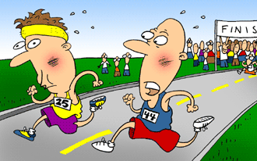
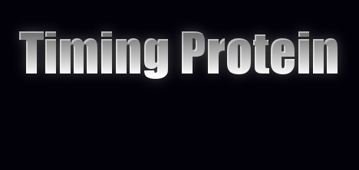
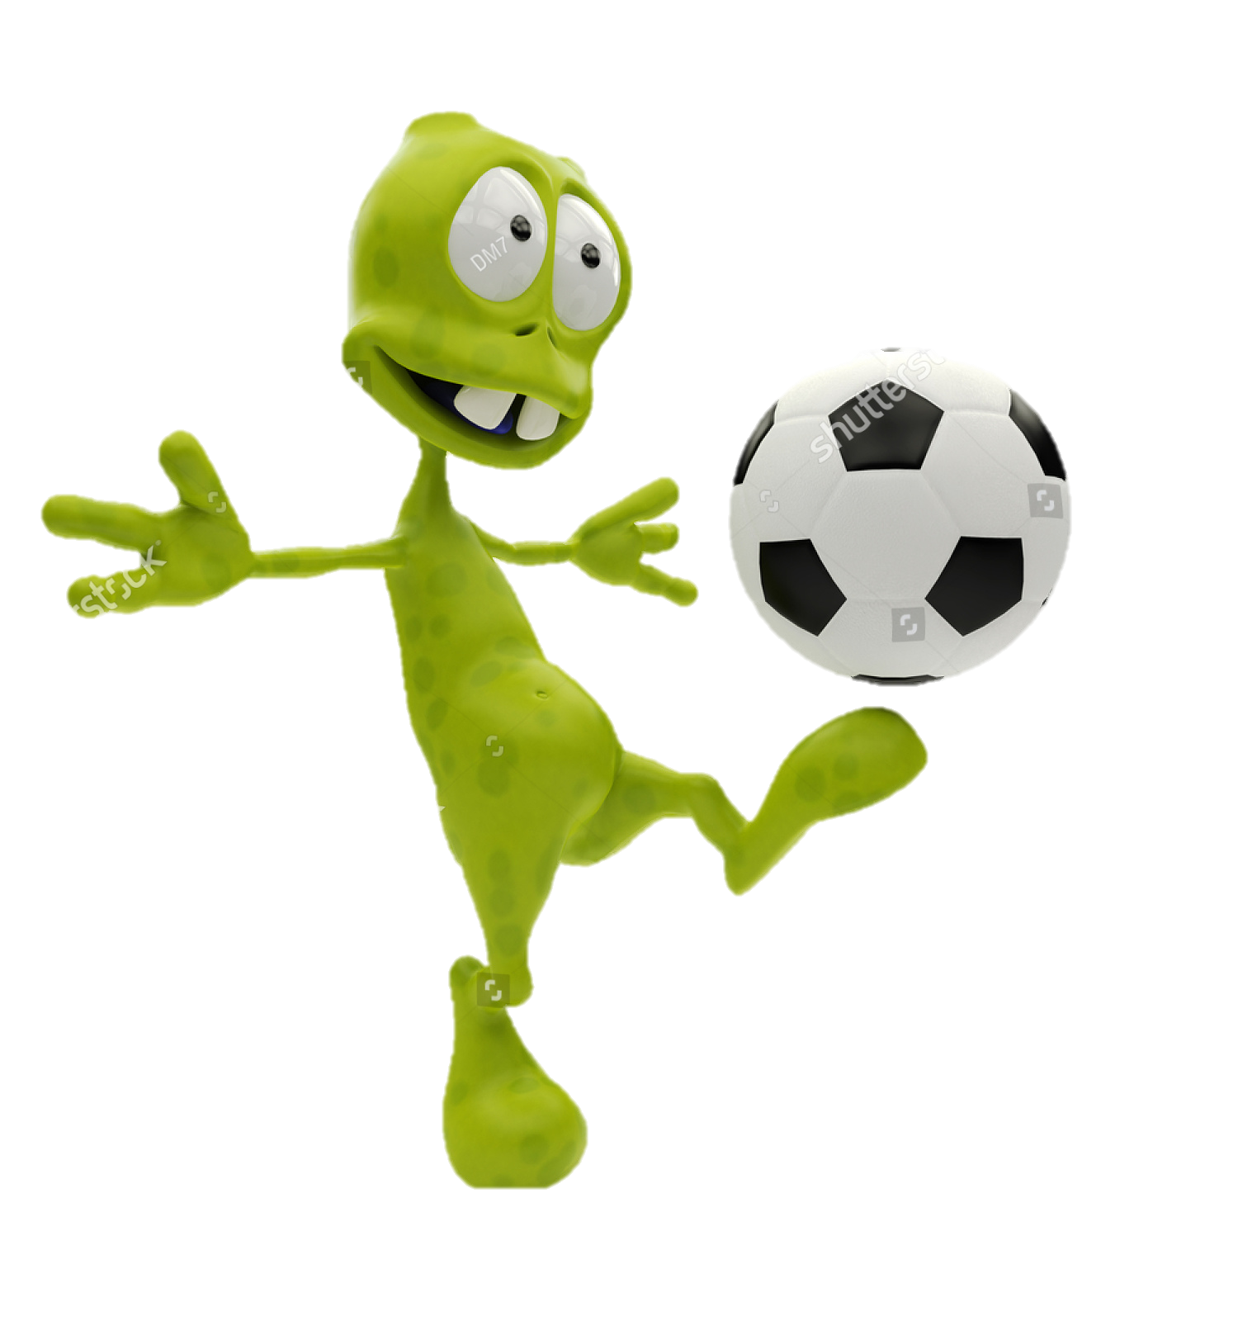
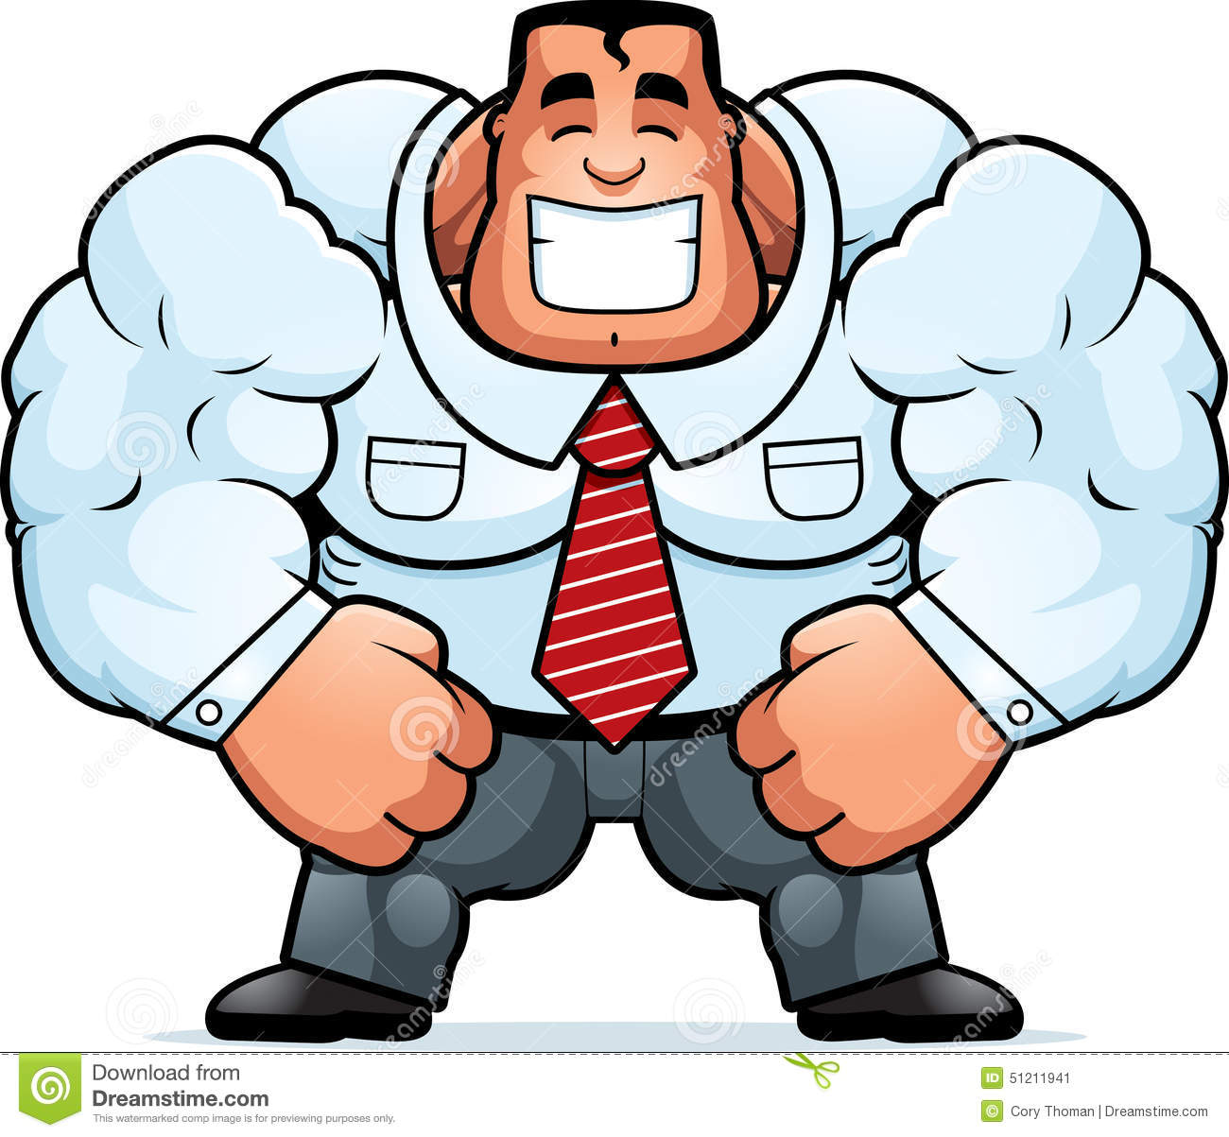
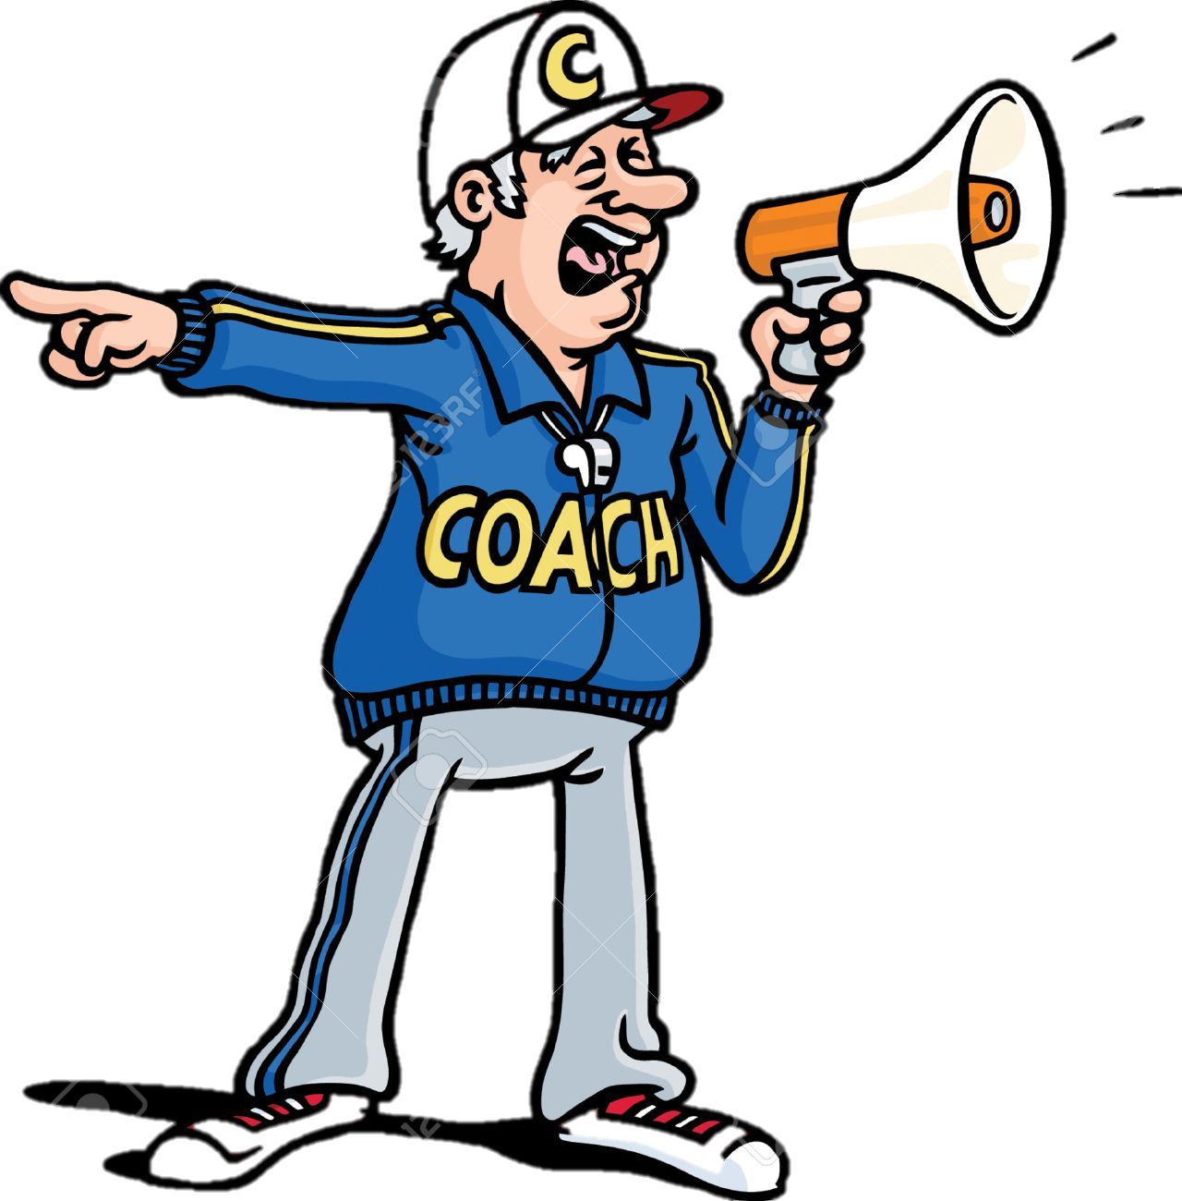
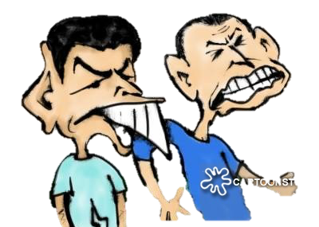
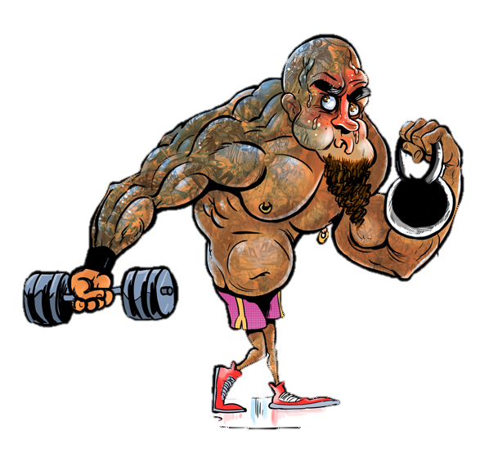
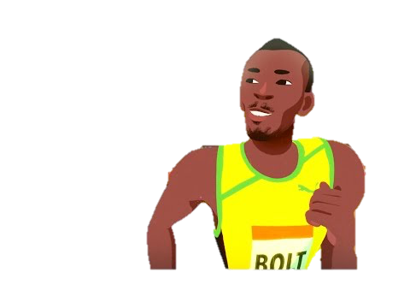
Obvious
L = lots of bits
Basic Skill
Low Organisational Skill
55-60%
25-30%
15-20%
Blood can flow easily, reducing the risk of CHD, strokes and damage to arteries
Increased self esteem (opinion of yourself) and confidence which makes you feel better about yourself e.g. feel you have achieved something
Simple skills, doesn’t need much concentration. E.g. running
One that can be easily broken down to be practiced separately e.g. front crawl, set shot
Macro nutrients – carbohydrates, fats and protein.
Micro nutrients –
Vitamins (A = growth and vision, B =needed for strong bones & C = body tissues together)
minerals (Calcium – strong bones and teeth, but also for muscle contraction. Iron – used in making red blood cells)
Water – In all food in bulk. Essential to the body, keeps temperature and keeps you hydrated. Dehydration = Blood thickening – this makes it harder for the heart to pump blood around meaning decreased flow of oxygen. Increased body temperature, leading to overheating, fainting through heat exhaustion
Fibre – keeps the digestive system active and helps lower cholesterol - Needed to keep your digestive system working. Meaning your body gets all the nutrients from the foods.
Reduce the risk of obesity
Competing against others / yourself can improve your ability to deal with pressure and mange emotions
C = Concentration
Complex Skill
High Organisational Skill
Aerobic exercise = prevents high blood pressure, heart stronger and arties elastic, helping remove cholesterol
Can relieve stress and tension by taking your mind off whatever is worrying you by making you feel happy. Preventing stress related illnesses
C = Concentration
This needs a lot of concentration to do e.g. volley in football
One that cant be easily broken down to be practiced separately as they are too closely linked e.g. front somersault
By training you can increase your components of fitness which will help your physical health:
The level of endorphins in your brain increases. These make your feel good, reducing the risk of mental illness such as depression.
O = ocean – always changes
Open Skill
Closed Skill
Increase levels of high density lipoproteins (HDL) – which removes cholesterol from arteries
Increased the level of serotonin in your brain. This may help reduce mental illness as low levels of serotonin are connected with depression
Changing environment, you have to react and adapt to external factors. E.g a tackle in basketball – you have to adapt to other player
Always performed in the same predictable environment. Not effected by external factors. E.g set shot in basketball
Weight baring exercise (e.g. where you use your feet and legs to support you e.g. running) – prevents osteoporosis
It can help you make friends with people of different ages and backgrounds.
Goal Setting
Reduces the chance of type-2 diabetes
Useful in making you successful, which will increase your self-worth. Being part of a team will help you feel more involved in society
Say exactly what you want to achieve.
Massed Practice
Distributed Practice
On Mass Cover = all together
Practicing with breaks for rest or mental rehearsal. Good for complex skills
Diet
lifestyle choices that effect performance.
Work/rest/sleep balance
Team activities like basketball, you have to practice teamwork, which improves how you cooperate and work with others
Practicing without breaks, good for basic skills
Makes you socialises with your current friends
They need to be measureable
Recreational drug
Activity levels
Verbal Guidance
They need to be the right level of difficulty
Fixed Practice
Variable Practice
‘An explanation in words of how to perform’
Practicing by repeating the same technique in one situation over and over again (drills). Good for closed skills
endurance athletes.
It maximizes the stores of glycogen (energy) in their muscles and liver.
carbohydrate high diet close to the event.
This will store in the liver and muscles ready to use.
Power athletes use this.
Body struggles to store this so you need to eat often.
Eat within an hour after training as they need to recover and repair themselves.
Take protein in before sleep as this is when you rest and recover.
Visual Guidance
Targets that you can realistically reach
Practicing by repeating the techniques in different situations that you might need to use it in. helps with open skills
A lifestyle where there is little, irregular or no physical activity
‘Visual clues, demonstration or videos and diagrams to show how it should be done’
Set a deadline
Being OVERWEIGHT
Weighing more then normal
Being OVERFAT
Having more body fat then your should
Being OBESE
Having A LOT more body fat then your should
Manual Guidance
fixated = over and over
vary = vary the situation
‘The coach physical moves the body through the techniques e.g. golf swing’
puts more strain on your cardiovascular system = less cardiovascular endurance.
Mechanical Guidance
Increased body fat – fatty deposits in the arteries, harder for the heart to pump blood – increase blood pressure, risk of stroke and CHD
Eat both after (within 2 hours) also to replace.
Guidance given through sports equipment e.g. harness in trampolining
Higher risk of developing type 2 diabetes
Ethnicity
Age
Gender
Socio-economic
Disability
Strain on your back and joints – bad posture and joint damage
Increase risk of osteoporosis – as body loses muscle tone and bone strength
Optimum Weight
Every
Alien
Do
Games/ PE
Should
‘What you should weigh for good health’
Intrinsic
Extrinsic
Can lead to emotional health problems so could lead to depression, lack of confidence etc
Sports Behaviour
Types of poor behavior
Reduces flexibility, speed and agility – so effects performance
But remember for sport =
You know how you feel (inside). You can ‘feel’ how it went. Good for experienced performers, they can judge how it went
Someone else (external) tells you or shows you what happened, how to improve. Suited to beginners – they don’t have experience or knowledge to accurately assess their own performance
* Different sports have different optimum weights.
* Sumo wrestler will need to be heavier then a marathon runner.
Sportsmanship
Gamesmanship
Deviance
Concurrent
Later (after)
Being honest, sticking to the rules and treating your opponents with respect
Gaining an advantage by using tactics that seem unfair, but aren't against the rules
Is behavior that goes against the moral values or laws of the sport
The four effects optimum body weight
Terminal
This is received during performance
Current = during
This is received after performance
Bone Structure
Energy Balance
The more media coverage a sports gets more people watch it. Making sponsorship more valuable, as it can reach a larger audience
Commercialisation, Media and Sponsorship
Product become expensive which people may not be able to afford
Gender -
Big,
Guys, Have, Muscle
N = no weight
P = Put on weight
P = Plus size
Sponsors may demand things done a certain way,
Height
Neutral energy balance =
Negative energy balance =
Positive energy balance =
Media makes more people aware so might play it
Commercialisation of sport is all about making money from it!
Some sports rules change
Same food and energy = maintain weight
More energy then food – weight loss
More food then energy – weight gain (fat stores)
Sponsors try and get to high achieving teams and sports people. They get money as they are associated with them
Advantages
Disadvantages
Beauty parade effect – the most attractive athletes may get the most support, meaning other good sports people get missed out
Muscle girth
Provides many sources of funds for individuals, groups and competition

Slide 7
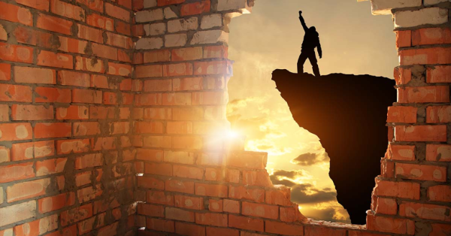
LETS BREAK IT DOWN….
REMEMBER…
You need to have some idea of all
BUT
Only focus on KNOWING two in detail
 | Good: | Outstanding:
3-5 | To be able identify 2 areas of P,E & S effects | To explain how some areas can reduce the health risks
6+ | To explain how some areas can reduce the health risks | TBT describe benefits of exercise and how they help in everyday life

Slide 8
Use the information in this PowerPoint to complete the next slide…

Slide 9
EXERCISE AND HEALTH BENEFITS

Slide 11
Good physical health can help your health by…
reduces the risk of CHD, strokes and damage to arteries
Exercise Reduces the risk of long term physical health
prevents high blood pressure,
Increase levels of high density lipoproteins (HDL) – which removes cholesterol from arteries
Challenge - How
Reduce the risk of obesity
can increase your components of fitness
Reduces the chance of type-2 diabetes Diabetes = high blood sugar level
 | Good: | Outstanding:
3-5 | To be able identify 2 areas of P,E & S effects | To explain how some areas can reduce the health risks
6+ | To explain how some areas can reduce the health risks | TBT describe benefits of exercise and how they help in everyday life
prevents osteoporosis

Slide 12
Challenge - Answers
Exercise Reduces the risk of LONG TERM health
reducing the risk of CHD, strokes and damage to arteries
Aerobic exercise = Blood can flow easily,
prevents high blood pressure,
Increase levels of high density lipoproteins (HDL) – which removes cholesterol from arteries
Low Aerobic exercise = Fat burning zone
By training using the different methods you will increase. E.g resistance training = hypertrophy of the muscles
Reduce the risk of obesity
can increase your components of fitness
This is when you don’t have enough insulin, this controls blood sugar or Body cells aren’t reacting to insulin (insulin-resistant). Exercise
keeps your weight down (preventing)
Reduces the likelihood of insulin-resistant
Reduces the chance of type-2 diabetes Diabetes = high blood sugar level
prevents osteoporosis
Weight baring exercise (e.g. where you use your feet and legs to support you e.g. running)

Slide 13
Exam Question:
Explain one way that regular exercise helps to prevent type-2 diabetes (2)
 | Good: | Outstanding:
3-5 | To be able identify 2 areas of P,E & S effects | To explain how some areas can reduce the health risks
6+ | To explain how some areas can reduce the health risks | TBT describe benefits of exercise and how they help in everyday life

Slide 15
Taking part in sport can have emotional benefits
relieve stress
Increased self esteem (opinion of yourself) and confidence
Exercise Reduces the risk of long term emotional health
Reducing the risk of mental illness
Challenge - How
Increased the level of serotonin to reduce depression
 | Good: | Outstanding:
3-5 | To be able identify 2 areas of P,E & S effects | To explain how some areas can reduce the health risks
6+ | To explain how some areas can reduce the health risks | TBT describe benefits of exercise and how they help in everyday life
improve your ability to deal with pressure and mange emotions

Slide 16
Challenge - Answers
Taking part in sport can have emotional benefits
relieve stress
by taking your mind off whatever is worrying you by making you feel happy. Preventing stress related illnesses
Increased self esteem (opinion of yourself) and confidence
which makes you feel better about yourself e.g. feel you have achieved something
Reducing the risk of mental illness
The level of endorphins in your brain increases. These make your feel good,
Increased the level of serotonin to reduce depression
Increased the level of serotonin (feel good molicule) in your brain. This may help reduce mental illness as low levels of serotonin are connected with depression
improve your ability to deal with pressure and mange emotions
Competing against others / yourself can get you ready and more mentally strong when difficult times come

Slide 17
Exam Question:
Callum has exams coming up but decides to continue playing football justify why this is a good idea(2)

Slide 19
help you make friends
Exercise Reduces the risk of long term Social health
Improve teamwork, which improves how you cooperate and work with others
Challenge - How
Challenge - How
Being part of a team will help you feel more involved in society
 | Good: | Outstanding:
3-5 | To be able identify 2 areas of P,E & S effects | To explain how some areas can reduce the health risks
6+ | To explain how some areas can reduce the health risks | TBT describe benefits of exercise and how they help in everyday life
Makes you socialises with your current friends

Slide 20
Challenge - Answers
Taking part in sport can have SOCIAL benefits
help you make friends
with people of different ages and backgrounds but of the same interests.
Improve teamwork, which improves how you cooperate and work with others
Team activities like basketball, you have to practice working together to be successful
Being part of a team will help you feel more involved in society
Useful in making you successful, which will increase your self-worth.
Makes you socialises with your current friends
Improves cooperation

Slide 21
Exam Question:
Ruby just moved to Dudley, she is a 35 year old female who has never played sport. Explain 3 benefits on her health if she joins her local netball team (3)

Slide 22
DO NOW ACTIVITY:
Exercise can keep you healthy, what does healthy mean and what are the benefits of being healthy? (7)
GREEN PEN
REDO…
1)Defo of health
2) Examples of each (good) explain (outstanding)
 | Good: | Outstanding:
3-5 | To be able identify 2 areas of P,E & S effects | To explain how some areas can reduce the health risks
6+ | To explain how some areas can reduce the health risks | TBT describe benefits of exercise and how they help in everyday life

Slide 23
Key
Task: Highlight each statement to its correct benefit
Aerobic exercise = prevents high blood pressure, heart stronger and arties elastic, helping remove cholesterol
Weight baring exercise (e.g. where you use your feet and legs to support you e.g. running) – prevents osteoporosis
Increased self esteem (opinion of yourself) and confidence which makes you feel better about yourself e.g. feel you have achieved something
It can help you make friends with people of different ages and backgrounds.
Useful in making you successful, which will increase your self-worth. Being part of a team will help you feel more involved in society
Competing against others / yourself can improve your ability to deal with pressure and mange emotions
The level of endorphins in your brain increases. These make your feel good, reducing the risk of mental illness such as depression.
Blood can flow easily, reducing the risk of CHD, strokes and damage to arteries
Increased the level of serotonin in your brain. This may help reduce mental illness as low levels of serotonin are connected with depression
Reduce the risk of obesity
Can relieve stress and tension by taking your mind off whatever is worrying you by making you feel happy. Preventing stress related illnesses
Team activities like basketball, you have to practice teamwork, which improves how you cooperate and work with others
Makes you socialises with your current friends
Increase levels of high density lipoproteins (HDL) – which removes cholesterol from arteries
By training you can increase your components of fitness which will help your physical health:
Reduces the chance of type-2 diabetes

Slide 25
Physical, Emotional, Social effect
Progress Indicators:
 | Good: | Outstanding:
3-5 | To be able identify 2 areas of P,E & S effects | To explain how some areas can reduce the health risks
6+ | To explain how some areas can reduce the health risks | TBT describe benefits of exercise and how they help in everyday life

Slide 26
ANSWERS

Slide 27
Exam Question:
Explain one way that regular exercise helps to prevent type-2 diabetes (2)
You are far more ay risk if you are overweight (1) exercise helps you maintain a healthy weight, this could prevent type 2 diabetes (1)
Exercise improves insulin sensitivity (1) this means you are less likely to become insulin-resistant, so are less likely to get type 2 diabetes (1)

Slide 28
Exam Question:
Callum has exams coming up but decides to continue playing football justify why this is a good idea(2)
Playing football will take his mind of the stress of exams (1)
plus
If he didn’t continue playing football he might get stressed out and develop mental health issues such as depression (1)
Or
The level of endorphins in his brain will increases meaning he will feel good

Slide 29
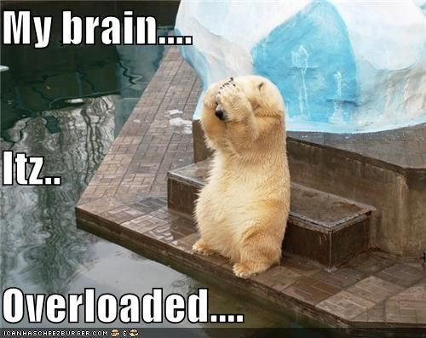
Exam Question:
Ruby just moved to Dudley, she is a 35 year old female who has never played sport. Explain 3 benefits on her health if she joins her local netball team (3)
3 benefits that haven’t been specific ALWAYS say ONE OF EACH!
Reduce the risk of obesity
relieve stress
help you make friends
Improve teamwork, which improves how you cooperate and work with others
prevents osteoporosis
Increased self esteem (opinion of yourself) and confidence

Slide 30
Key
Task: Highlight each statement to its correct benefit
Aerobic exercise = prevents high blood pressure, heart stronger and arties elastic, helping remove cholesterol
Weight baring exercise (e.g. where you use your feet and legs to support you e.g. running) – prevents osteoporosis
Increased self esteem (opinion of yourself) and confidence which makes you feel better about yourself e.g. feel you have achieved something
It can help you make friends with people of different ages and backgrounds.
Useful in making you successful, which will increase your self-worth. Being part of a team will help you feel more involved in society
Competing against others / yourself can improve your ability to deal with pressure and mange emotions
The level of endorphins in your brain increases. These make your feel good, reducing the risk of mental illness such as depression.
Blood can flow easily, reducing the risk of CHD, strokes and damage to arteries
Reduce the risk of obesity
Increased the level of serotonin in your brain. This may help reduce mental illness as low levels of serotonin are connected with depression
Can relieve stress and tension by taking your mind off whatever is worrying you by making you feel happy. Preventing stress related illnesses
Team activities like basketball, you have to practice teamwork, which improves how you cooperate and work with others
Makes you socialises with your current friends
By training you can increase your components of fitness which will help your physical health:
Increase levels of high density lipoproteins (HDL) – which removes cholesterol from arteries
Reduces the chance of type-2 diabetes

Slide 31
Mark Scheme
0-2
3-4
5

Slide 32
Connect
0-2
3-4
5
List and state the 3 Benefits of exercise with 1 examples of each
Explain how health is improved through exercise giving 2 examples of each type of benefits
Justify which type of benefit is most improved for a 55year old female who lives on her own.

