Slide 1
80/20 – THINK! What do you NEED to cover with your set
Grade | Learning Objective | Learning Outcome
1-3 | Explain how endocrine system controls the internal environment of your body | Describe the endocrine system and define the term hormone.
4-6 |  | Label a diagram of the organs in the endocrine system.
7-9 |  | Explain why the pituitary gland is often called the master gland.

Slide 2
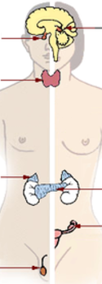
The endocrine system
Do now activity:
What do you already know about the endocrine system?
What are some of the major differences between hormonal control and nervous control in the body?
Can you name any glands which produce hormones? And identify the hormones they release?
Notes:
Endocrine gland image by US Government [Public domain], via Wikimedia Commons

Slide 3
Progress indicators
GOOD PROGRESS:
Describe the endocrine system and define the term hormone.
Label a diagram of the organs in the endocrine system.
OUTSTANDING PROGRESS:
Explain why the pituitary gland is often called the master gland.

Slide 4
Recap: The endocrine system
Key Words: organ, response, receptors, hormones, glands
The endocrine system is made up of ______ that secrete chemical's called ________ directly into the blood stream.
The blood carries the hormone to its target _______ (or organs).
The target organ has ______ on the cell membranes that pick up the hormone, triggering a ______ in the cell.

Slide 5
Self-assessment:
glands
The endocrine system is made up of ______ that secrete chemical's called ________ directly into the blood stream.
The blood carries the hormone to its target _______ (or organs).
The target organ has ________on the cell membranes that pick up the hormone, triggering a ________ in the cell.
hormones
organ
receptor
response

Slide 6
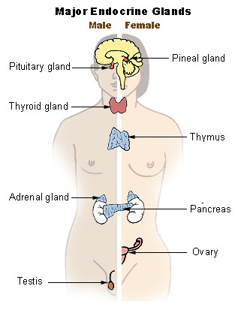
Can we name any of the organs shown in the diagram below?
Pancreas
Thyroid
Adrenal Gland
Kidney
Ovaries
Testes
Pituitary gland
Kidney
Check your work!
Notes:
Endocrine gland image by US Government [Public domain], via Wikimedia Commons

Slide 7
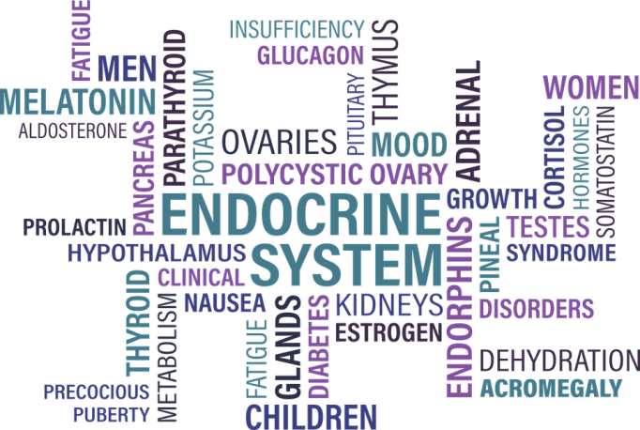
Task: Discuss in pairs and try to match the gland to the hormones they release:
Pituitary gland
Pancreas
Ovaries
Kidney
Testes
Thyroid
Adrenal Gland
Produces adrenaline
Produces insulin
Produces testosterone
Produces thyroxine
Produces oestrogen
Produces ADH
Produces vitamin D

Slide 8
Self-assessment:

Slide 9
Task: 1. Draw the following table into your books:
Endocrine gland | Role of hormones
Pituitary
Thyroid
Pancreas
Adrenal
Ovaries
Testes
2. In groups you will be given a set of cards which contains information about the role of each of the hormones released by the glands listed above. You need to discuss which card matches with each gland and copy the correct information into your table.

Slide 10
Self-assess your work
Pituitary | Controls growth in children Stimulates the thyroid gland to make thyroxine In women – stimulates the ovaries to produce and release eggs & make oestrogen In men – stimulates the testes to make sperm and testosterone
Thyroid | Controls the metabolic rate of the body
Pancreas | Controls the levels of glucose in the blood
Adrenal | Prepares the body for stressful situations
Ovaries | Controls the development of the female secondary sexual characteristics, involved in the menstrual cycle
Testes | Controls the development of the male secondary sexual characteristics and is involved in the production of sperm

Slide 11
Quick Check: Silent 5
What is a hormone?
What is an endocrine gland?
Explain how the coordination and control by hormones differs from that of the nervous system
Suggest, and explain, why the pituitary gland is sometimes called the master gland of the endocrine system
(1 mark)
(1 mark)
(6 mark)
(3 marks)

Slide 12
Task: Exam-style Question
Progesterone
Oestrogen
Hormone level
0 4 8 12 16 20 24 28 32 36 40
Weeks of pregnancy
1. Describe the patter of progesterone and oestrogen levels from week 4 to week 36 of pregnancy.
(4 marks)

Slide 13
Self-assess your work
Any four (must include at least one statement about progesterone and oestrogen):
Progesterone starts being produced at 4 weeks
From four weeks the level of progesterone begin to increase
Oestrogen is at a constant level from 0 – 20 weeks
From 20 weeks oestrogen begins to increase
From 20 – 36 weeks the level of oestrogen rises more steeply than progesterone

Slide 14
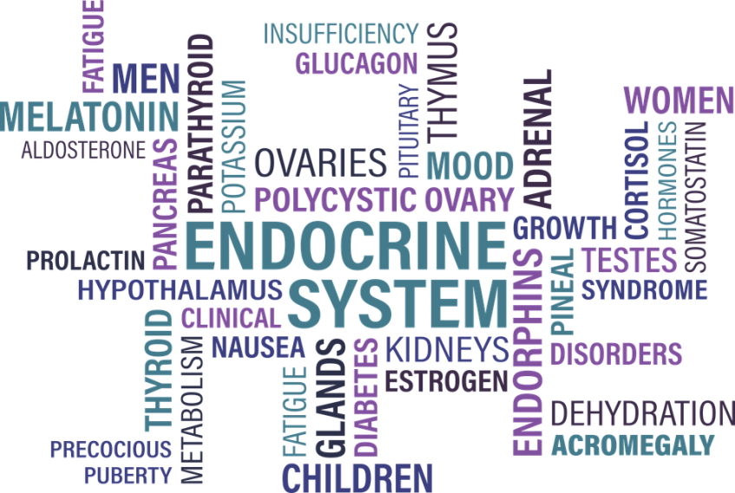
Plenary: For each set of words, link them together in a sentence:
Endocrine, gland, chemical
ADH, brain, gland
Testes, sperm, hormone
Adrenalin, insulin, thyroxine
Glucose, pancreas, control

Slide 15
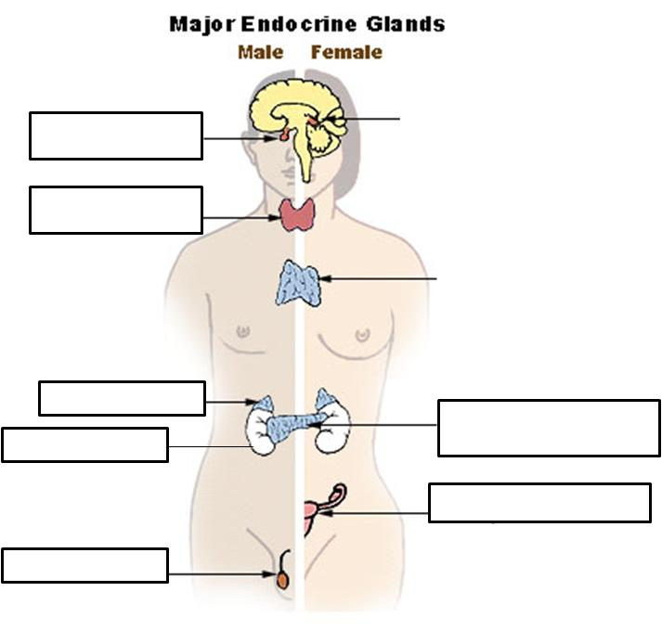

Slide 16
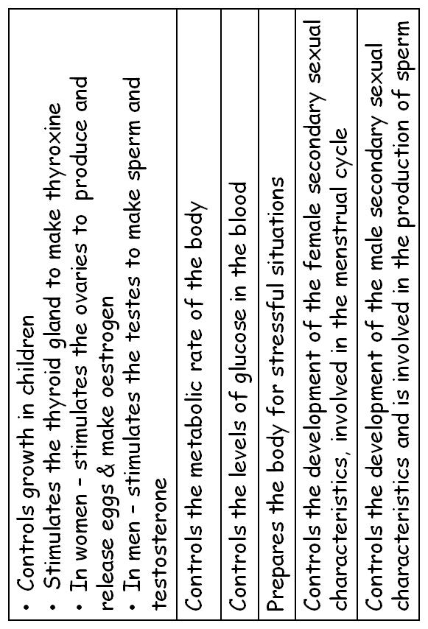
Notes:
Cut out and give one each to pupils

