Slide 1
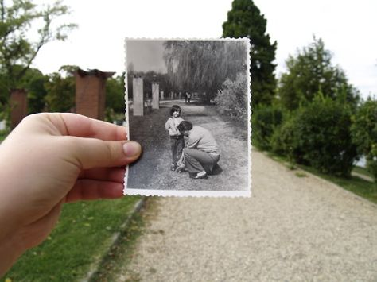
DNA
What can you tell me about this image?

Slide 2
Take notes on the presentation to help with your reference page

Slide 3
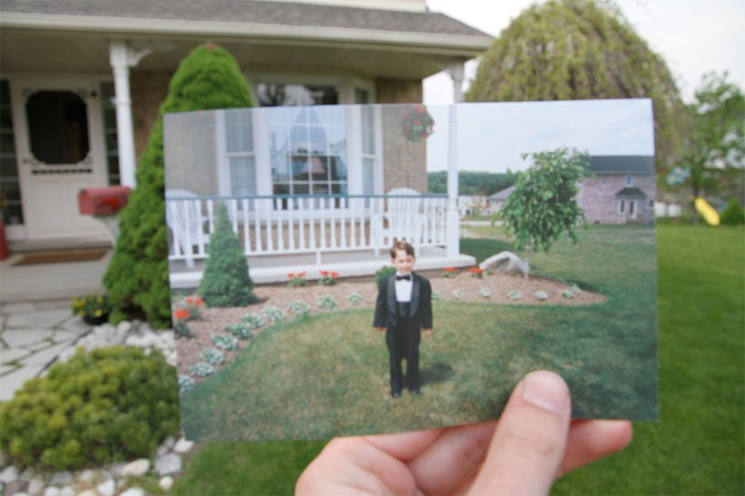
Dear Photograph by Taylor Jones
The submission above to ‘dear photograph’ by founder Taylor Jones, with the caption ‘dear photograph, I looked good in a tux.’
dear photograph is a web-based project by Canadian artist Taylor Jones, calling for people to ‘take a picture of a picture from the past, in the present’ by recapturing the sites of old photographs. each image has a caption that begins with ‘dear photograph,’ followed by a memory– sometimes poignant, often funny– sharing nostalgic images layered in time. It has become a wildly popular blog.
People are invited to submit their own ‘dear photographs’ by email to dearphotograph@gmail.com.

Slide 4
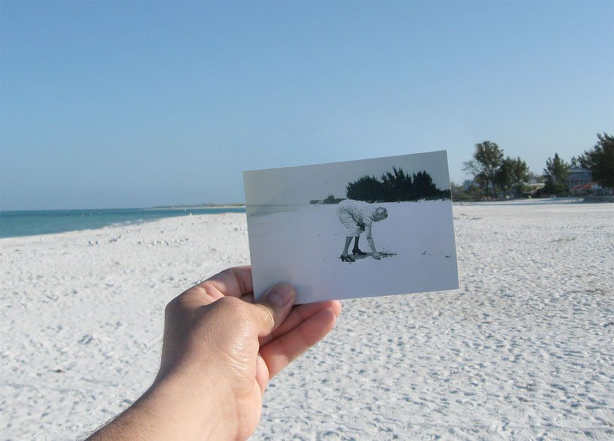
‘dear photograph, grandma loved this beach.’ by dan perry

Slide 5
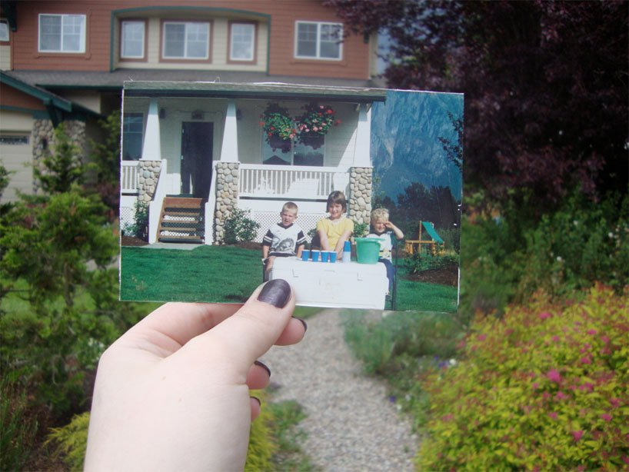
‘dear photograph, I wish I could still have a lemonade stand business.’ by @xandyevans

Slide 6
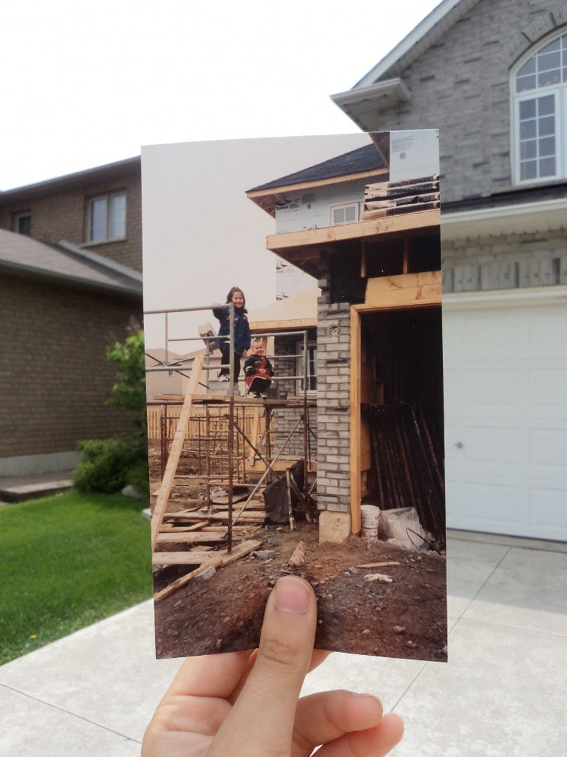
‘dear photograph, I wonder which parent let us up there?’ by @bedaub

Slide 7
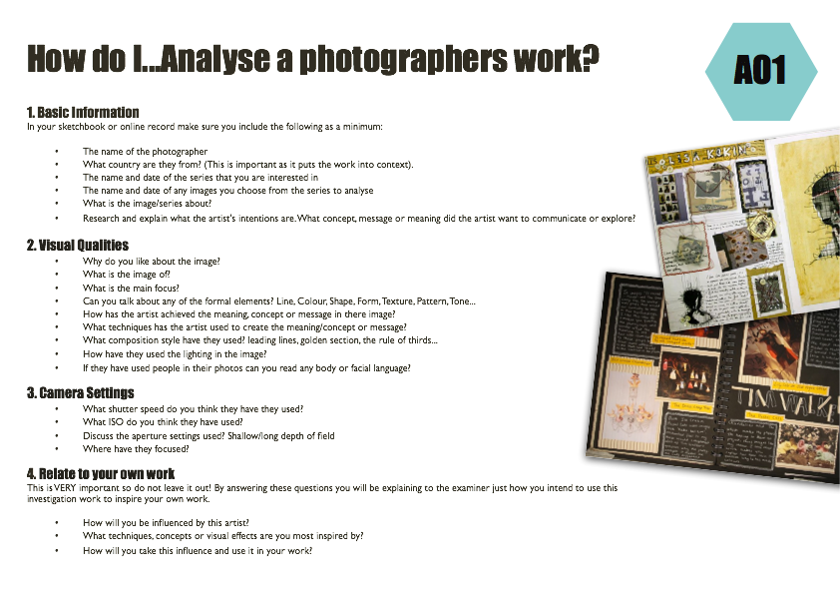
To gain an understanding of the project ‘Dear Photograph’
Title:- Dear Photograph Project
GCSE photography Progress Indicators
Basic Requirements | Described the work of Taylor Jones and Dear Photograph Presented a selection of images by the photographer in your sketchbook Added the photographers name to the page
Good | Answered some questions from each heading on the ‘How do I…Analyse a Photographers work?’ sheet A range of neatly cut out and presented images for the project
Outstanding | Answered most questions from all the headings on the ‘How do I…Analyse a Photographers work?’ sheet Writing uses detailed and in-depth sentences Creative layout/design for the page used
TASK 1
Find at least 6 images you like and print. Find as much information (plus what you have noted down
https://www.designboom.com/art/taylor-jones-dear-photograph/
TASK 2
Using the ‘Analysing photographers’ handout handwrite or type up your analysis of one of your found images.
TASK 3
Write the photographers name – Creatively- in your A3 paper and creatively present the images, (discussing at least one photo in detail, information about the project/artist, camera settings, composition of the photos and possible ideas)
Leave room to discuss your ideas

Slide 8
Peer Assessment of Reference Page
Pass your reference page with the PIN sheet in a clockwise directions (to your left)
1st person – write a positive comment about their work – and NOT JUST it looks nice!!!
Pass the paper and PIN sheet to your left on your table
2nd person – write an improvement comment – something that might be missing
Pass both sheets back to the owner
Owner – to now say what they are going to do
next to improve/finish work
Glue to the back of your reference page
What is needed on the reference page:-
Creative Title
Minimum of 5 photographs of his work
Information about Slinkachu and his people project
Discussion of at least one photo in detail
Possible ideas they have based on his style of work

Slide 9
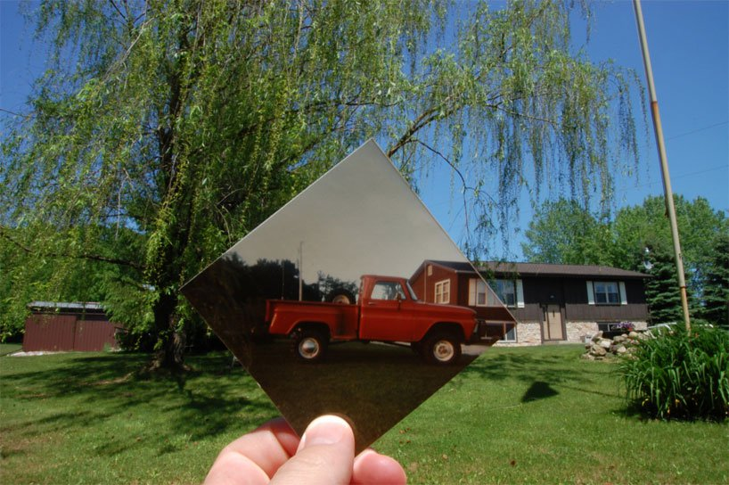
PLENERY
What can you NOW tell me about this project?
What camera settings of you think have been used in the image above?
How will you be influenced by this artist?

Slide 11
Peer Assessment Reference Page
Using the sheet/table look through what your partner has done so far on their reference page and tick if completed fully
Glue the assessment to the back of their large paper and hand back for them to complete this lesson

