Slide 1
80/20 – THINK! What do you NEED to cover with your set
Grade | Learning Objective | Learning Outcome
1 | Describe the process of breathing | Recall the process of inhaling and exhaling Describe how a bell jar can be used to model what happens during breathing Explain how to measure lung volume.
2
3

Slide 2
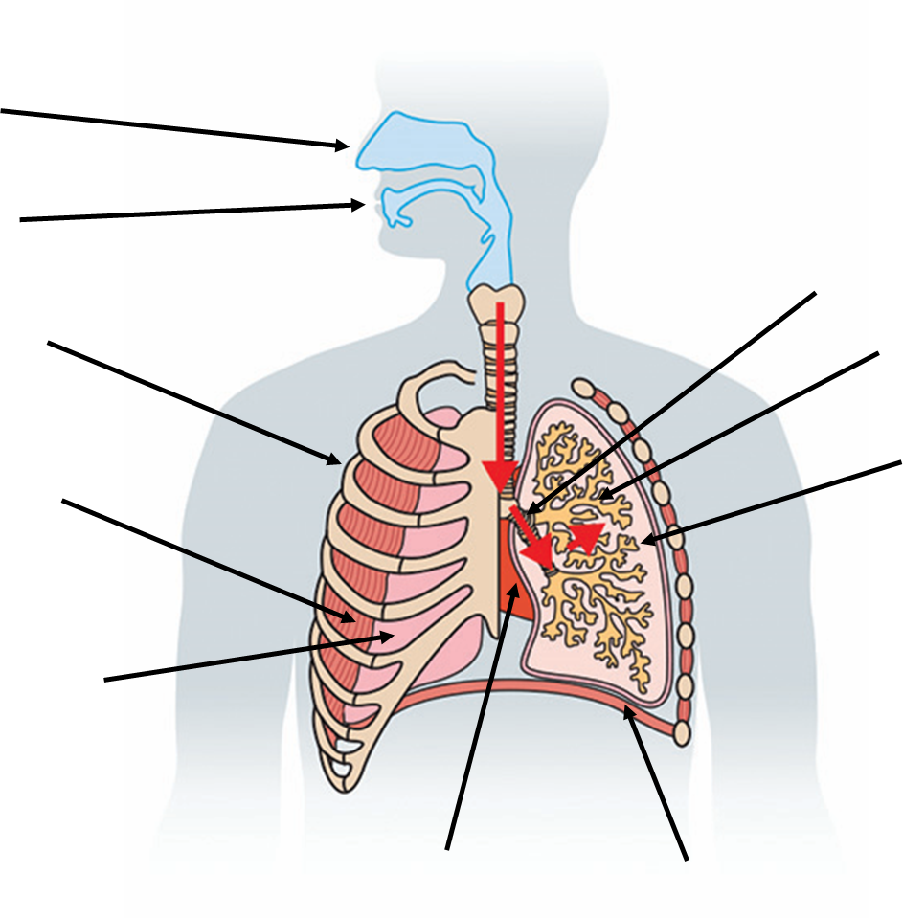
Breathing
Do now activity: Try to label as many parts of the respiratory system as you can!!

Slide 3
Progress indicators
GOOD PROGRESS:
Recall the process of inhaling and exhaling
Describe how a bell jar can be used to model what happens during breathing
OUTSTANDING PROGRESS:
Explain how to measure lung volume.

Slide 4
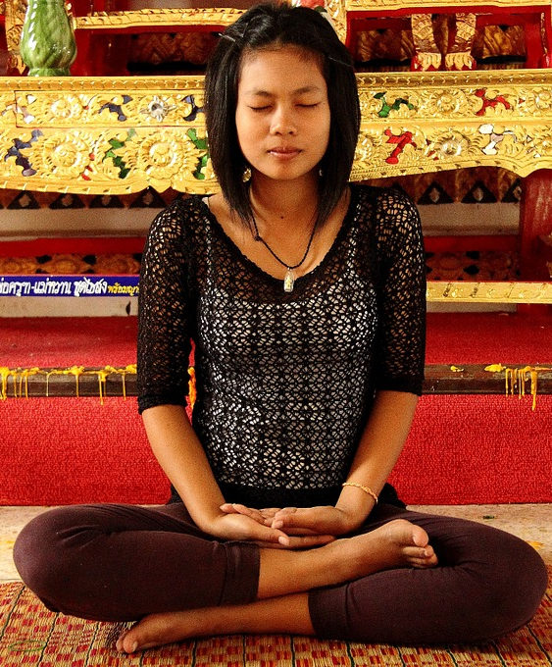
How do you breathe?
Just sit quietly for a few minutes and think about what is happening when you breathe in and out.
What does it feel like?
What do you notice happening to your chest?
As you breathe in you should feel your chest tighten as muscles contract.
You should observe your chest rising and falling as you breathe in and out, this movement is helped by your intercostal muscles moving your ribcage.

Slide 5
Breathing in and breathing out
Task: Watch the video and complete the following sentences:
During inhalation (breathing in), the intercostal muscles ________, pulling the ribcage upwards and _______. The diaphragm also contracts, which causes it to lie _____. Overall, the volume of the thorax ________ and the pressure ________, this draws air into the lungs.
During exhalation (breathing out), the intercostal muscles _______, pulling the ribcage inwards and ______. The diaphragm _______, returning to a dome shape. Overall, the volume of the thorax _________ and the pressure increases, this forces air ____ of the lungs.
https://www.youtube.com/watch?v=ylEknRf0jLU

Slide 6
Self-assessment:
During inhalation (breathing in), the intercostal muscles contract, pulling the ribcage upwards and outwards. The diaphragm also contracts, which causes it to lie flat. Overall, the volume of the thorax increases and the pressure decreases, this draws air into the lungs.
During exhalation (breathing out), the intercostal muscles relax, pulling the ribcage inwards and downwards. The diaphragm relaxes, returning to a dome shape. Overall, the volume of the thorax decreases, and the pressure increases, this forces air out of the lungs.

Slide 7
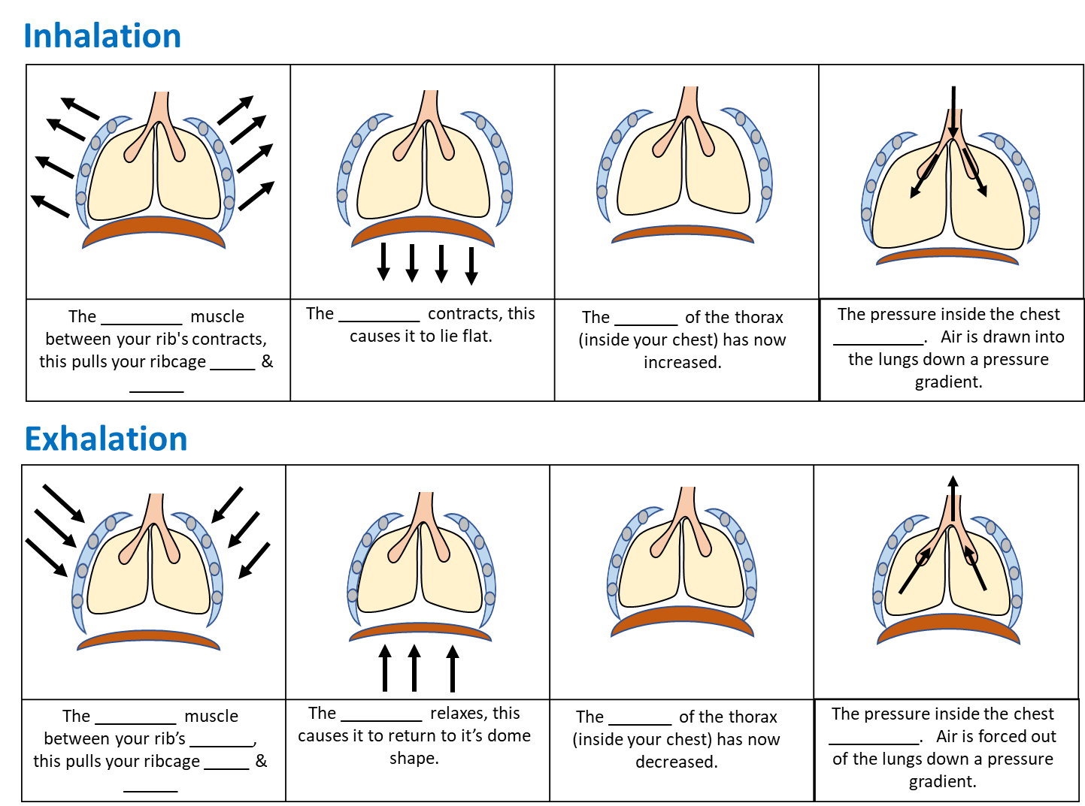
Task: Complete the cartoon strip to demonstrate what happens to the lungs during inhalation and exhalation

Slide 8
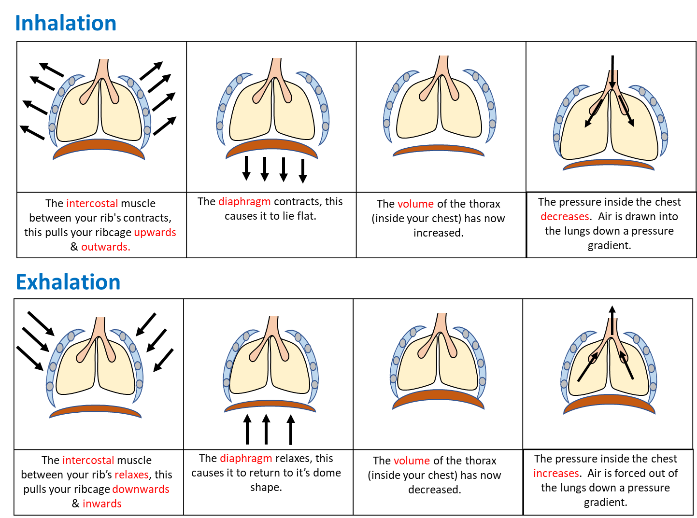

Slide 9
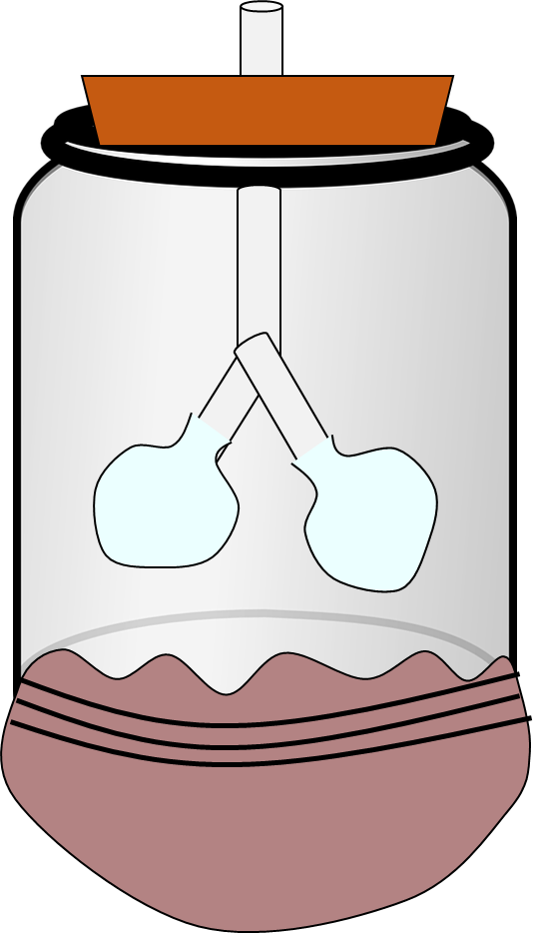
The Bell Jar
We can use a bell jar to demonstrate the process of breathing in and out.
The jar represents your chest
The balloons are your lungs
The rubber sheet underneath is your diaphragm

Slide 10
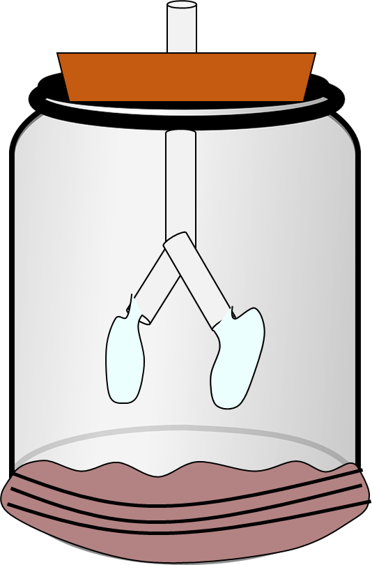
Teacher Demo ~ Bell Jar
Observe what happens when the rubber sheet is pulled downwards.
What is happening to the balloons? Explain why this happens in terms of volume and pressure.
Observe what happens when the rubber sheet is pushed upwards.
What is happening to the balloons? Explain why this happens in terms of volume and pressure.

Slide 11
Self-assessment:
As the rubber sheet is pulled downwards, the volume of the gas increases, this decreases the pressure. Air is then drawn into the bell jar, filling the balloons.
As the rubber sheet is pushed upwards, the volume of the gas decreases, this increases the pressure. Air is then forced out of the bell jar, which is why the balloons deflate.

Slide 12
How do we measure lung volume?
You can measure your lung volume using the apparatus shown here.
By breathing out fully into the plastic tube you can measure your total lung volume.
As the air flows into the plastic bottle it will displace water, the total volume of water pushed out of the bottle is equal to how much air your lungs can hold!!
Plastic bottle (full of water)
Plastic tube
Tank with water

Slide 13
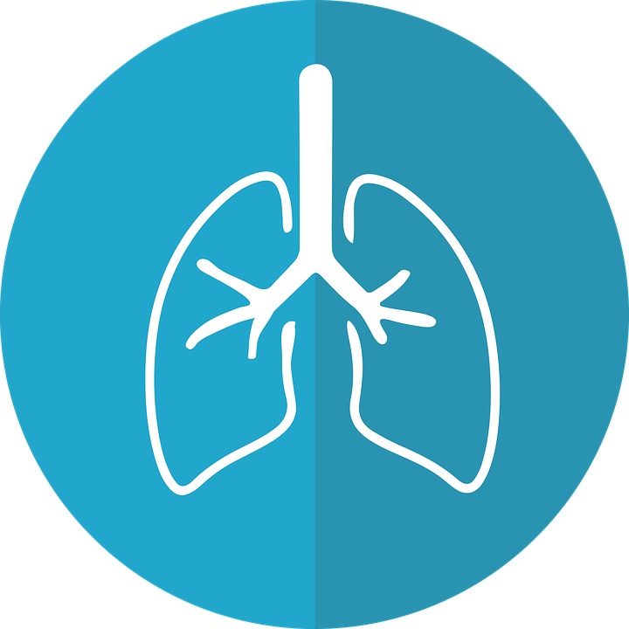
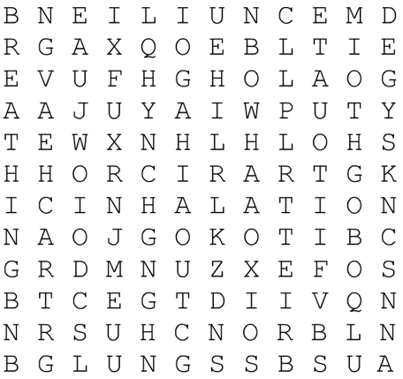
Plenary ~ Word search
Find the following words in the word search:
Alveoli
Breathing
Oxygen
Trachea
Bronchus
Bronchiole
Exhalation
Inhalation
Lungs

Slide 14
Resources

Slide 15
Inhalation
The _________ muscle between your rib's contracts, this pulls your ribcage _____ & ______
The _________ contracts, this causes it to lie flat.
The _______ of the thorax (inside your chest) has now increased.
The pressure inside the chest __________. Air is drawn into the lungs down a pressure gradient.
Exhalation
The _________ muscle between your rib’s _______, this pulls your ribcage _____ & ______
The _________ relaxes, this causes it to return to it’s dome shape.
The _______ of the thorax (inside your chest) has now decreased.
The pressure inside the chest __________. Air is forced out of the lungs down a pressure gradient.
Notes:
Middle – Lower Ability: Fill – in – the – blank

Slide 16
Inhalation
Exhalation
Notes:
High Ability: Complete own captions

Slide 18
