Slide 1
DNA
Find the area of the blue shape:
The circle has a radius of 4cm.
The square has a side of 1cm.
The triangle has a base of 2cm and a height of 1cm.
Write down the steps of what you would have to calculate to answer the question.
Notes:
Option 1

Slide 2
Connect
A circle has an Area of 240cm². Find the radius. A circle has a Circumference of 282cm. Find the diameter.
A circle has an Area of 2.85cm². Find the radius and diameter. A circle has a Circumference of 37.5cm. Find the radius and diameter.
Find the area
Notes:
Reliant on knowledge of types of number on a dice.
Green introduces idea of “or” to stretch students understanding.

Slide 3
Arc Length and Area of Sectors
Unit 9 Objective G + H

Slide 4
Progress Indicators

Slide 5
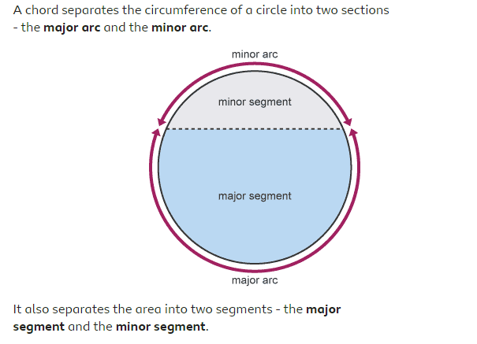

Slide 6
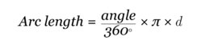
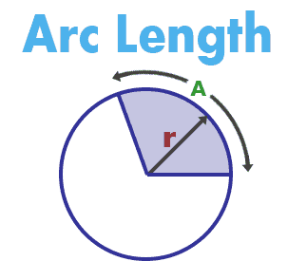

Slide 7
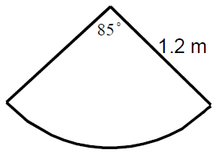
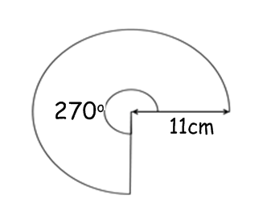
Calculate the arc length
I Do
We Do

Slide 8
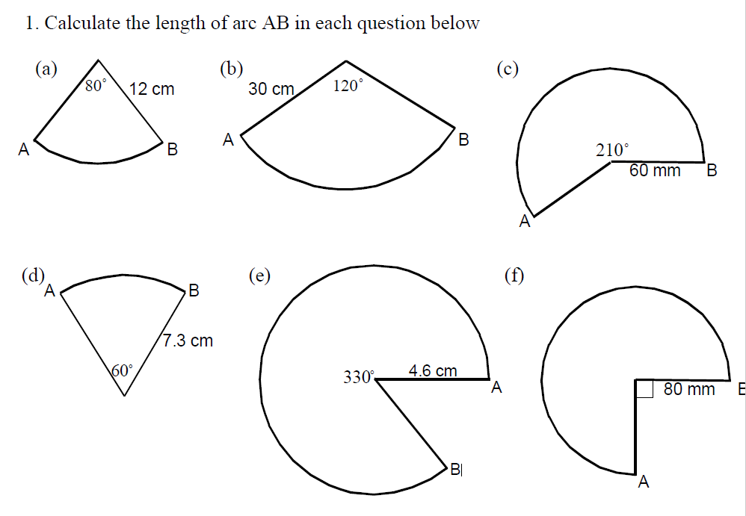
Intelligent Practice

Slide 9
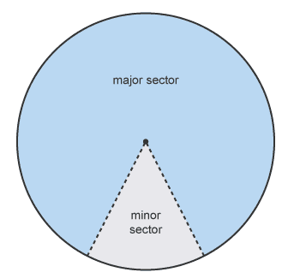
Sectors

Slide 10
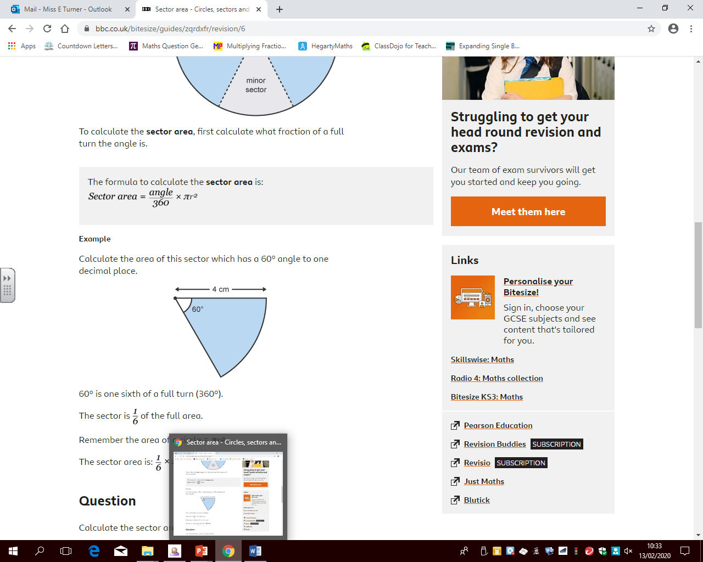

Slide 11
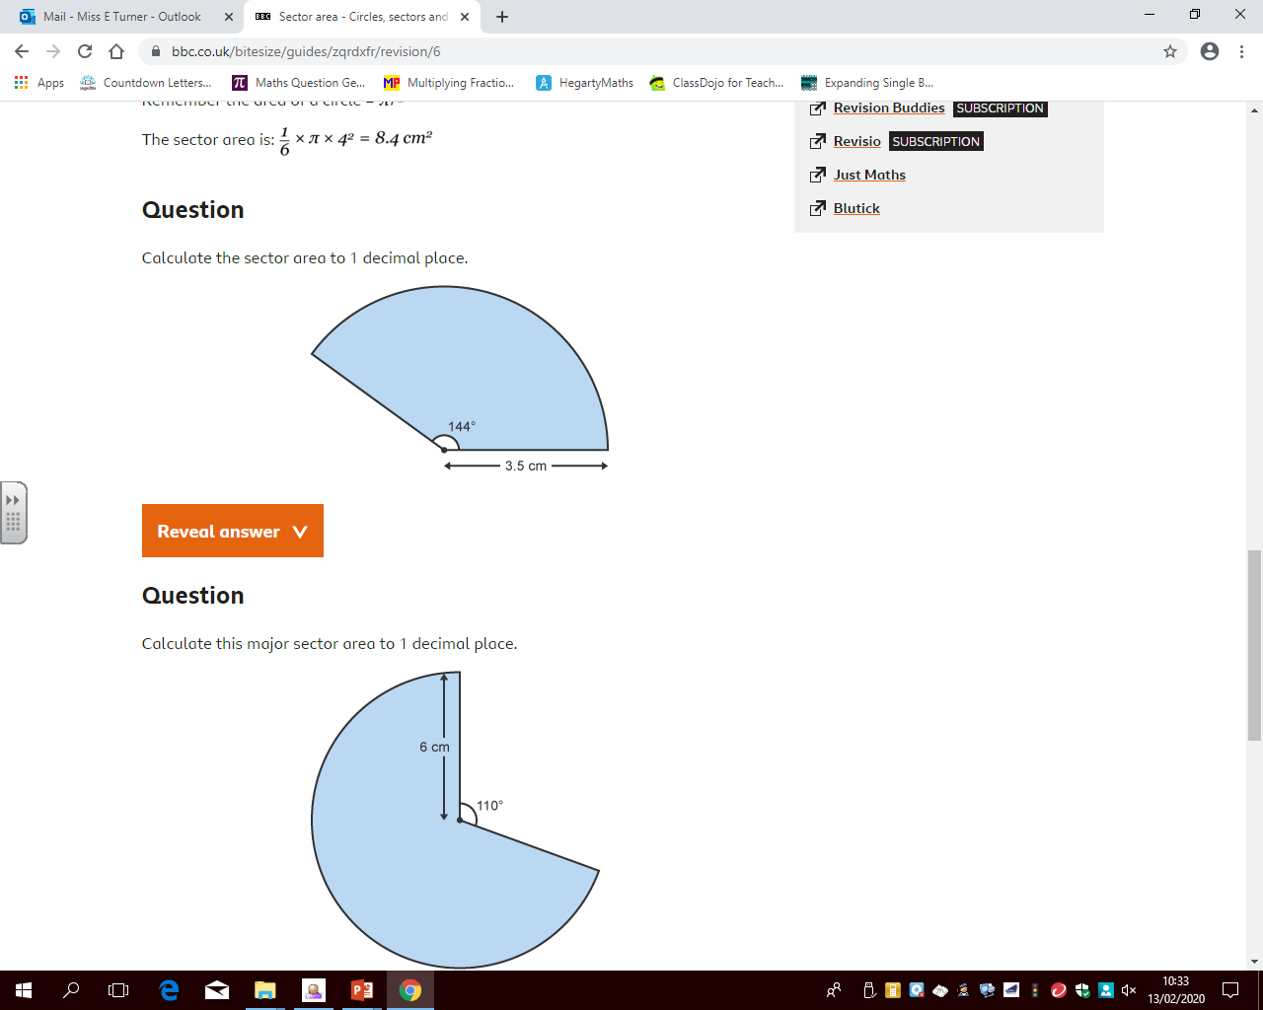
Calculate the area
I Do
We Do

Slide 12
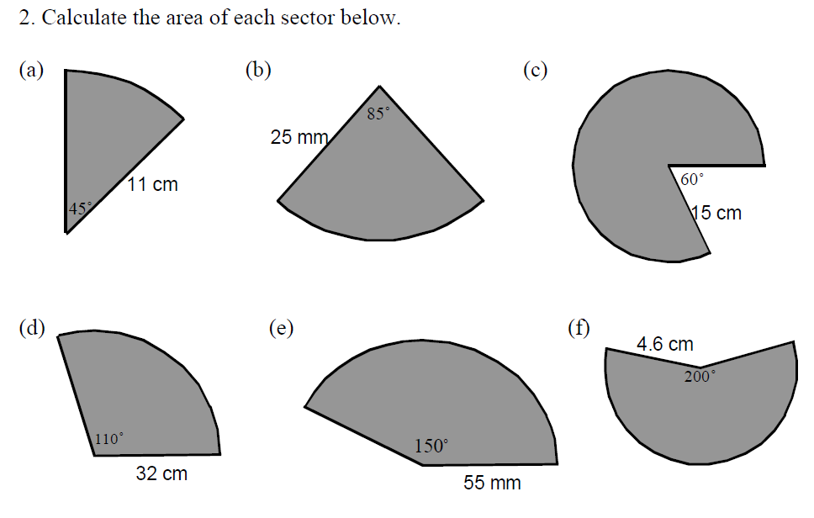
Intelligent Practice

Slide 13
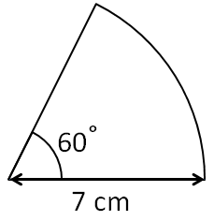
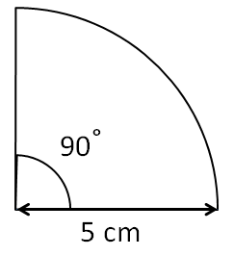
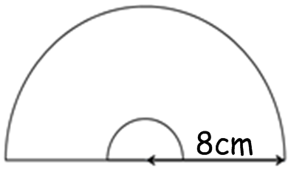
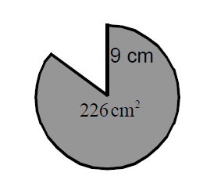
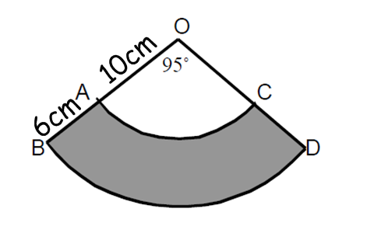
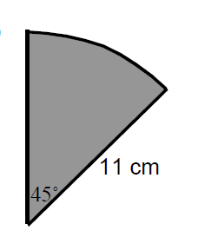
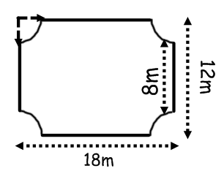
Demonstrate
Calculate the arc length
Calculate the area
Stretch

