Slide 1
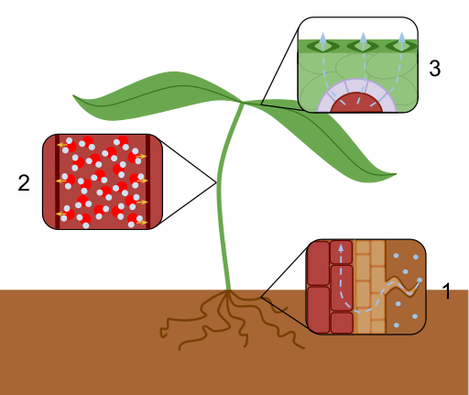
Factors affecting Transpiration
Do now activity:
Which cells open and close the stomata?
Describe the process of transpiration?
Explain why the root hair cell in the plant needs a large surface area.
Notes:
Image by Laurel Jules - Own work, CC BY-SA 3.0, https://commons.wikimedia.org/w/index.php?curid=26331125

Slide 2
Progress indicators
GOOD PROGRESS:
- Identify the 4 factors which affect the rate transpiration
- Describe how to use a potometer to investigate transpiration
OUTSTANDING PROGRESS:
- Explain the factors which can affect the rate of transpiration

Slide 3
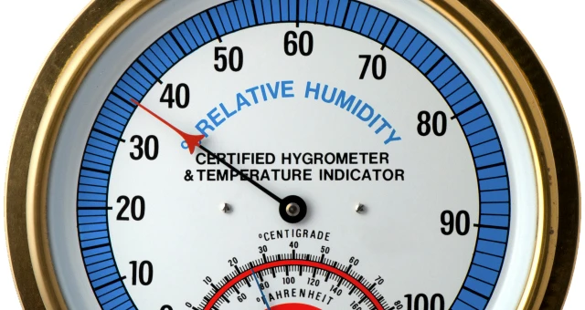
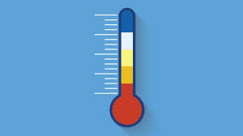
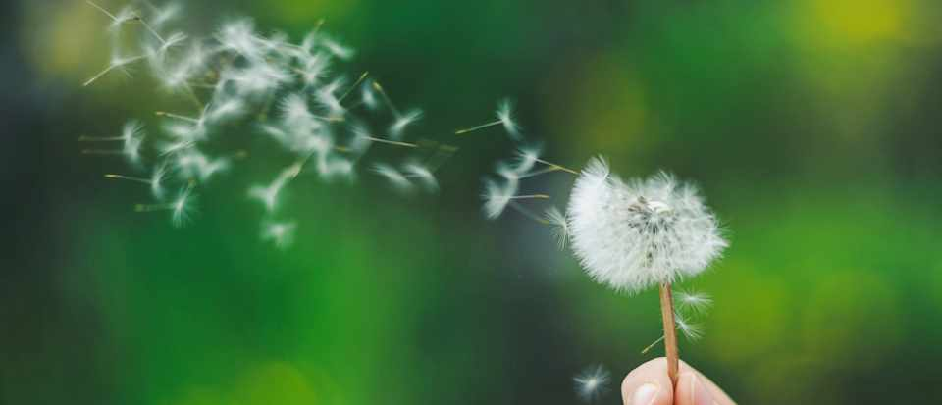
What are the 4 factors affecting the rate of transpiration
HUMIDITY – how much moisture is in the air
TEMPERATURE
LIGHT INTENSITY
WIND
Challenge: HOW do you think these 4 factors affect transpiration? Which ones speed it up…and which ONE slows it down?

Slide 4
Factors affecting the rate of transpiration
Task: You have each been given a different slip of information about a factor that affects the rate of transpiration.
You will need to walk around the room and share the information to complete the following table in your books:
Environmental Factor | How this factor effects the rate of transpiration | Sketch graph
Light intensity
Humidity
Temperature
Wind
Challenge: Draw a sketch graph to illustrate how the rate of transpiration would be affected

Slide 5
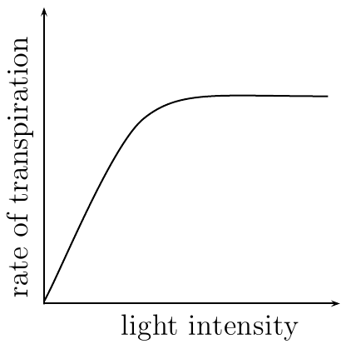
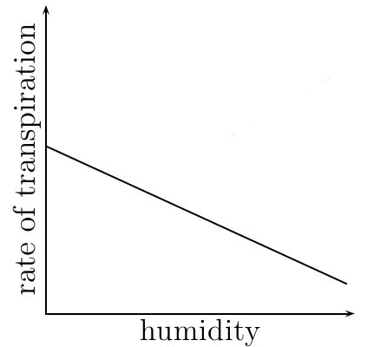
Self-assessment:
Environmental Factor | How this factor effects the rate of transpiration | Sketch Graph
Light intensity | An increased light intensity would increase the rate of photosynthesis. The stomata will be open to increase the rate at which carbon dioxide enters and therefore more water will be lost from the leaves due to evaporation; therefore increasing the rate of transpiration
Humidity | If the air around a leaf has a low concentration of water molecules (less humid, dry conditions). The concentration gradient between water molecules in the leaf and the surrounding air will be quite steep. Therefore, water molecules will evaporate from the surface off the leaf more readily, increasing the rate of transpiration

Slide 6
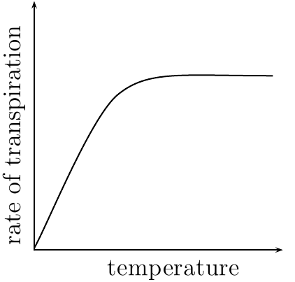
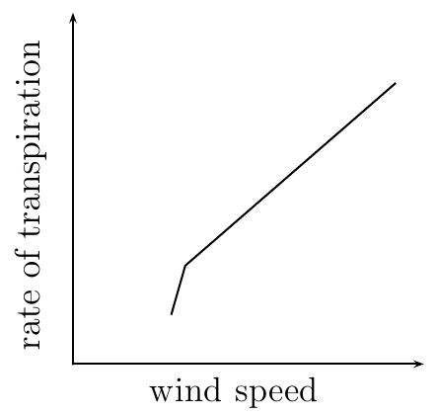
Self-assessment:
Environmental Factor | How this factor effects the rate of transpiration | Sketch Graph
Temperature | An increase in temperature will mean that molecules move more rapidly, this would cause more water molecules to evaporate from the surface of the leaf and an increase in transpiration. A temperature increase would also cause the rate of photosynthesis to increase, this means the stomata are open for gas exchange and so more water will leave the surface of the leaf, once again increasing the rate of transpiration
Wind | If a plant is in windy conditions it will mean that there will be an increase in the rate of evaporation from the surface of the leaf as water molecules will be taken away more easily, this will increase the rate of transpiration.

Slide 7
Exam-style question: Turn to the back of your book and answer the following questions, in silence:
6 marks = 6 minutes
What is the function of the stomata
(1)
Describe how water moves from the roots to the leaves (2)
Give three environmental conditions which could increase the rate of transpiration (3)

Slide 8
Self-assessment:
Stomata lets carbon dioxide enter the plant / lets oxygen out of the plant / controls loss of water from the plant (1)
Water moves from the root to the leaves due to the transpiration stream / pull
This occurs in the xylem (2)
3. Any three from: wind / dry or low humidity / hot or warmer conditions (3)

Slide 9
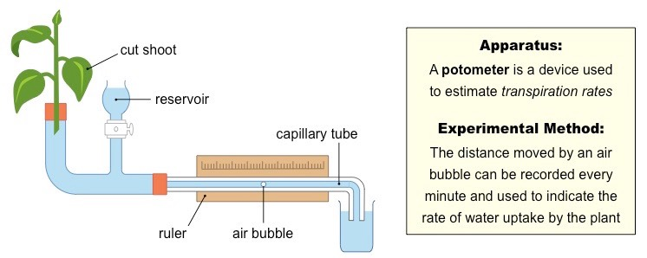
How do we measure the rate of transpiration?
Challenge: How could I get the air bubble back to the start of the ruler to do the test again?

Slide 10
PLENARY: Exam question practice, answer the following questions in silence:
6 marks = 6 minutes

Slide 11
Self-assessment:
(a) (i) wind and temperature
answers in either order
ignore weather
2
(ii) different plants have different sizes / different numbers of leaves / different sizes of leaves / different plants take up different amounts of water
ignore reference to validity
allow different plants need
different amounts of water
1
(b) in table, in sequence: C, B, A
all 3 correct = 2 marks
2 correct = 1 mark
0 or 1 correct = 0 mark
2
(c) transpiration
1
[6]

Slide 12
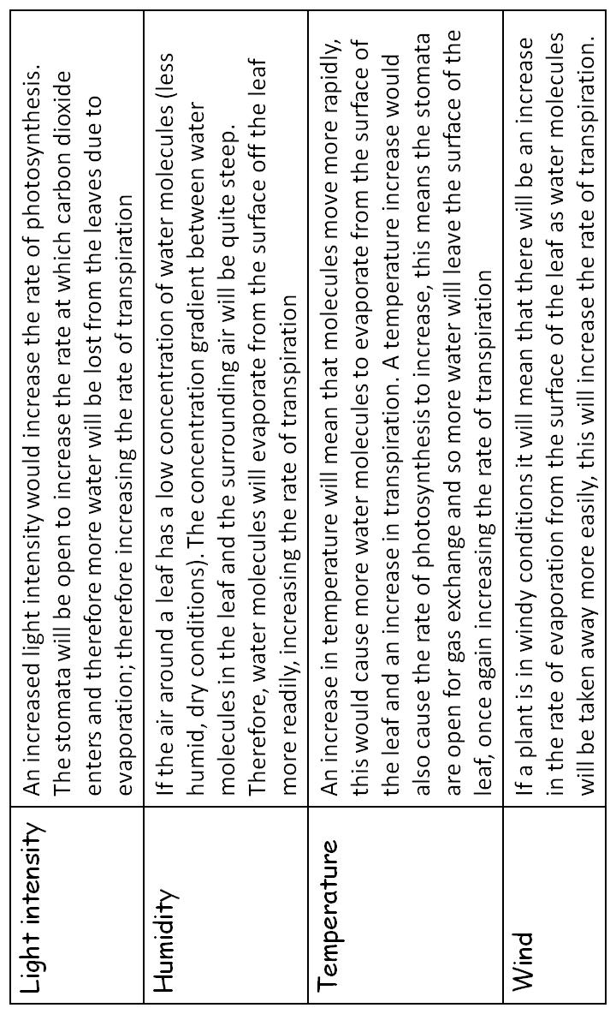
Notes:
Cut this information up into strips, give each student a different bit of information. They will then need to swap information with each other to complete their own table.

