Slide 1
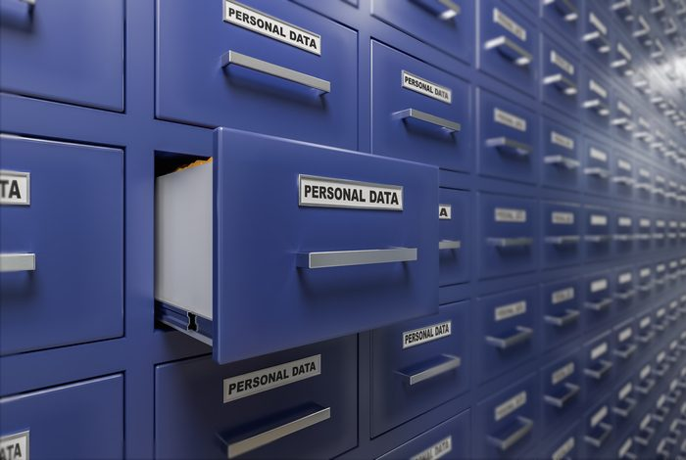
Do Now Activity
Page 9 of your booklet
Examples of personal data
Think about data stored by…
Social Media
Police / Medical Centres
Retailers
Schools
Government / Council
Technology Companies

Slide 2
Do Now Activity - Answers

Slide 3
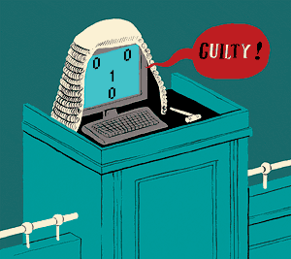
Unit 7 Ethical, Legal, Cultural and Environmental Concerns
Progress Indicators
Good – Describe three forms of computer legislation
Outstanding – Discuss the impact of this legislation on organisations
Legislation= the process of making or enacting laws

Slide 4
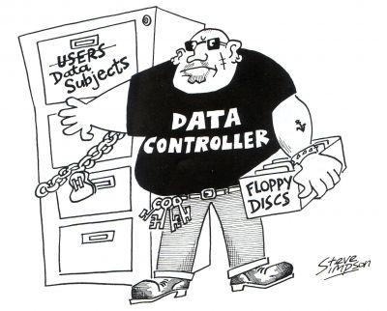
Data Protection Act 1998
As computers became more and more widespread, new laws were needed to protect individuals and organisations data from harm. The DPA was introduced in 1998. It tells organisations, that store data, exactly how they can and can’t use it. It also gives people the right to access and change it.
Two terms you need to understand…
Data Subject
The individual that the data relates to
Data Controller
The person(s) in an organisations that
determine how the data is collected,
processed and stored

Slide 5
Data Protection Act 1998
Why does data need protecting?
Personal data about each one of us is held on dozens, or even hundreds, of computers
We would like to be confident that this data is accurate and held for a specific purpose
A lot of this data is private and confidential and should not be available for anyone to look at
It should also be kept safe from people who want to use it for wrongful or criminal purposes

Slide 6
Do Now Activity – Groups of 4
On whiteboards (1 per table)
List as many of the 8 Principles of the Data Protection Act as you can?

Slide 7
Data Protection Act 1998
The DPA includes 8 principles:
Data must be collected and used fairly and inside the law.
Data must only be held and used for the reasons given to the Information Commissioner.
Data can only be used for the purpose for which it was collected. You cannot give it away or sell it unless you said you would to begin with.
The information held must be adequate, relevant and not excessive when compared with the purpose stated in the register. So you must have enough detail but not too much for the job that you are doing with the data.
Data must be accurate and be kept up to date. There is a duty to keep it up to date, for example to change an address when people move.
Data must not be kept longer than is necessary for the registered purpose. It is alright to keep information for certain lengths of time but not indefinitely.
The information must be kept safe and secure. This includes keeping the information backed up and away from any unauthorised access.
Data may not be transferred outside of the European Economic Area (that's the EU plus some small European countries) unless the country that the data is being sent to has a suitable data protection law.

Slide 8
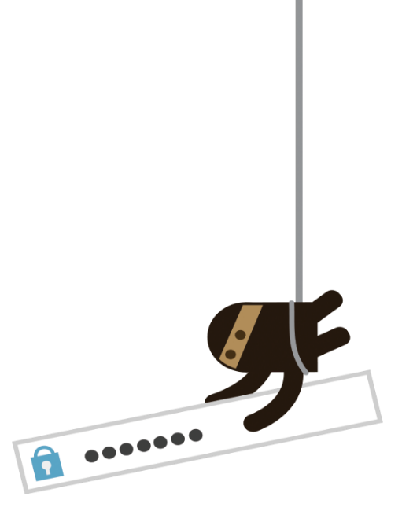
Computer Misuse Act 1990
The Act was created to close a loophole in UK law regarding the intentional malicious use of computers. It is designed to protect computer users against deliberate attacks and theft of information. This was passed by Parliament and made three new offences:
Offence | Penalties
Level 1 - Unauthorised Access | Unauthorised Access (level 1) is called a summary offence and penalties are limited to 6 months imprisonment and/or a maximum fine of £5000
Level 2 - Unauthorised access with intent to commit another offence | The other two offences (levels 2 and 3) are more serious and carry jail terms of up to 5 years and unlimited fines
Level 3 - Unauthorised modification of data (writing viruses comes under this level)

Slide 9
Computer Misuse Act 1990 - Example
A student hacks into a college database to impress his friends
unauthorised access
Later he decides to go in again, to alter his grades,
He deletes a whole class worth of grades
unauthorised access
with intent
unauthorised modification of data

Slide 10
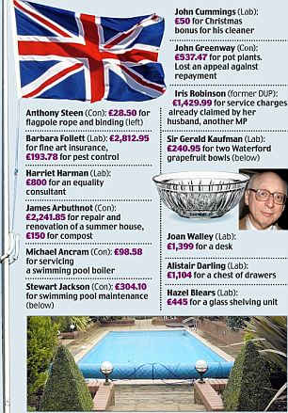
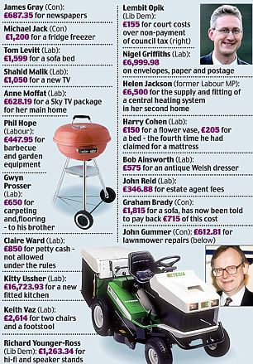
Freedom of Information Act 2000
This Act gives individuals and organisations the right to request official information held by over 100,000 public bodies. Some of these public bodies include:
Government / Local authorities
Hospitals, doctors’ surgeries, dentists, pharmacists and opticians
Schools, colleges and universities
Police forces and prison services
This information can include things such as e-mails, minutes of meetings, research or reports. Anyone, anywhere in the world can send a request to see the information, however there are some exemptions. Public authorities can refuse to supply or even confirm if they hold the information if:
It affects national security or perhaps because it might be personal data and be protected under the Data Protection Act
The request is vexatious (it is designed to cause disruption or annoyance)
A similar request has been made in the past
The cost of supplying the information exceeds an appropriate limit
In May 2015, the media requested details of expense claims by leading politicians

