Slide 1
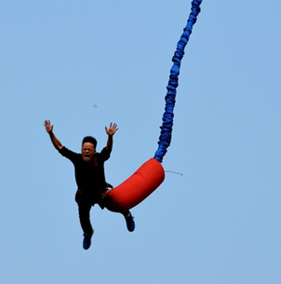
Energy Stores and transfers
Do now activity:
Keywords
Energy
Stores
Transfer
Gravitational potential
Name different stores of energy
Can you describe any types of energy transfer?
Can you describe a simple energy transfer?

Slide 2
Progress indicators
GOOD PROGRESS:
State some examples of energy stores.
State the processes that can transfer energy from one store to another.
OUTSTANDING PROGRESS:
Construct energy transfer diagrams.

Slide 3
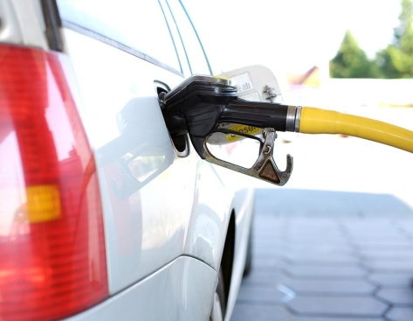
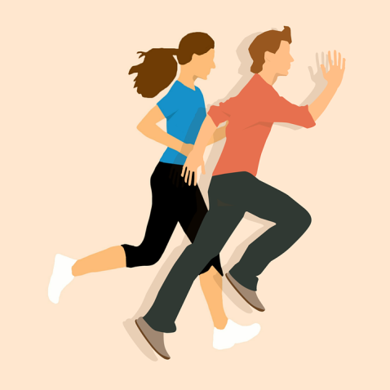
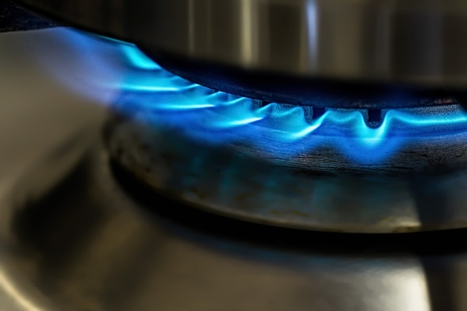
Energy can be stored in different ways and transferred too. Below are some images which represent some types of energy stores. What do you think they might be? THINK!
chemical
gravitational potential
elastic potential
kinetic
thermal

Slide 4
TASK: There are five ways in which energy can be stored:
Task: Finish the words and then match with the correct description from below!
C…
Th….
K…
Gr….
El…
Nu…
M
The type of energy that is stored within a moving object
The type of energy that can be stored in a springy object if you stretch or squash it
The energy stored when repelling poles have been pushed closer together or when attracting poles have been pulled further apart.
The type of energy that is stored in an object that has the potential to fall due to gravity
This energy stores includes fuels, foods, or the chemicals found in batteries. The energy is transferred during chemical reactions
This describes the energy store a substance has because of it’s temperature
The energy stored in the nucleus of an atom.

Slide 5
Self-assessment:
CHEMICAL = This energy stores includes fuels, foods, or the chemicals found in batteries. The energy is transferred during chemical reactions
THERMAL = This describes the energy store a substance has because of it’s temperature
KINETIC = The type of energy that is stored within a moving object
GRAVITATIONAL POTENTIAL = The type of energy that is stored in an object that has the potential to fall due to gravity
ELASTIC POTENTIAL = The type of energy that can be stored in a springy object if you stretch or squash it
NUCLEAR = The energy stored in the nucleus of an atom.
MAGNETIC = The energy stored when repelling poles have been pushed closer together or when attracting poles have been pulled further apart.

Slide 6
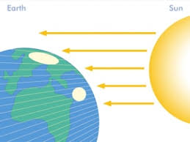
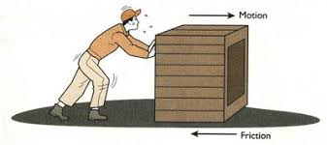
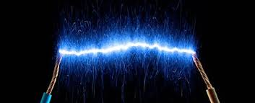
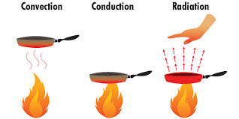
There are also different ways in which energy can be transferred. Look at the pictures below and try and figure out what they might be!
radiation - energy tranferred as a wave, eg light and infrared
mechanical work - a force moving an object through a distance
heating - due to temperature difference caused electrically or by chemical reaction
electrical work - charges moving due to a potential difference

Slide 7
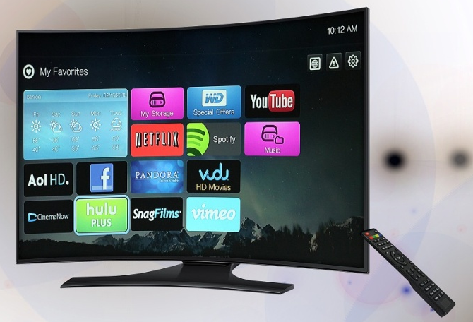
Look at these energy transfer diagrams…can you complete them?
Ch______ energy store in the candle
emical
Light energy
Thermal energy
Energy is transferred to the surroundings
ectrical
El______ energy is transferred to the TV
Light energy
Sound energy
Thermal energy
Energy is transferred to the surroundings

Slide 8
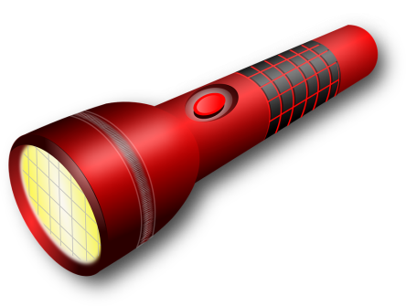
Quick check– what is happening in the torch?
Task: Match the correct statement to the correct box
Light waves
Chemical energy store in the battery
Electric current in the wires
Energy transferred to the surroundings
Increase in the thermal energy store of the surroundings

Slide 9
Self-assessment:
USEFUL
Light waves
WASTED
Chemical energy store in the battery
Electric current in the wires
Energy transferred to the surroundings
Increase in the thermal energy store of the surroundings
CHALLENGE: Which energy do you think is useful and which do you think is wasted?

Slide 10
Task: Bungee jumping – energy transfers
After the bungee jumper has jumped the energy in the rope is transferred from the g_______ p_______ energy store to the k________ energy store as the bungee jumper falls due to gravity.
When the rope tightens the bungee jumper slows. The jumpers kinetic energy store decreases and the rope’s e_______ p________ energy i________ as the rope stretches. Eventually the jumper comes to a stop.
After reaching the bottom the rope recoils and pulls the jumper back. The energy in the e_______ p________ energy store of the rope decreases and the bungee jumper’s kinetic energy store increases until the rope becomes slack.
Task: Fill in the blanks and draw a diagram to represent what the captions are explaining.

Slide 11
Self-assessment:
After the bungee jumper has jumped the energy in the rope is transferred from the gravitational potential energy store to the kinetic energy store as the bungee jumper falls due to gravity.
When the rope tightens the bungee jumper slows. The jumpers kinetic energy store decreases and the rope’s elastic potential energy increases as the rope stretches. Eventually the jumper comes to a stop.
After reaching the bottom the rope recoils and pulls the jumper back. The energy in the electrical potential energy store of the rope decreases and the bungee jumper’s kinetic energy store increases until the rope becomes slack.

Slide 12
Plenary: Exam-style question
Name four appliances designed to transform electrical energy into heat energy. (4)
What form of energy is transferred as waste energy by the television set? (1)
iron, hairdryer (other hair appliances), kettle, electric heater, electric cooker
Heat energy

