Slide 1
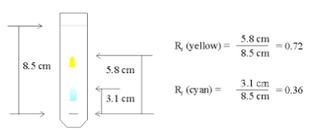
CwK
Wednesday, 07 October 2020
Gas tests
Do Now Activity
Calculate the Rf values for the yellow and blue spots.

Slide 2
Self Assess
Yellow Rf = 5.8/8.5 =0.68
Blue Rf= 3.1/8.5 =0.36

Slide 3
Progress Indicators
Good Progress
Carry out the test for oxygen, hydrogen and carbon dioxide
Outstanding Progress
Describe the test for oxygen, chlorine, hydrogen and carbon dioxide

Slide 4
Word Consciousness

Slide 5
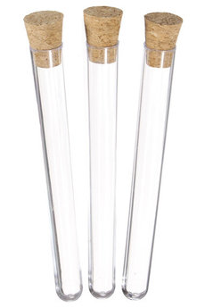
What is in the test tubes?
Oxygen
Carbon dioxide
Nitrogen
Air
We don’t know – all of those things look the same but we can do tests to find out!

Slide 6
Results Table
Gas | Test | Observation
Hydrogen
Oxygen
Carbon Dioxide
Chlorine
Put damp litmus paper in gas.
Litmus paper bleaches and turns white.

Slide 7
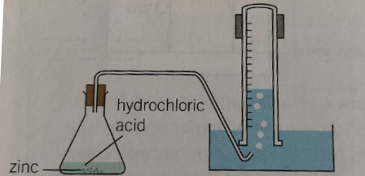
Hydrogen test
Collect a test tube of hydrogen gas
Hold a lighted splint at the open end of the test tube
Record what happens in your table

Slide 8
Carbon Dioxide test
Bubble carbon dioxide through limewater
Record what happens to the limewater

Slide 9
Oxygen test
Collect 15cm³ of hydrogen peroxide
Add a small amount of manganese oxide using a spatula
Insert a glowing splint
Record what happens to the splint

Slide 10
A Mystery Substance
A student has an unknown substance and wants to find out what it is. It is a solid and she knows it is a compound that contains zinc. She pours hydrochloric acid on it. She notices it fizzes so she collects the colourless gas. She assumes it is oxygen so completes the test for oxygen but doesn’t get the expected result.
What did she do to test for oxygen? What was she expecting to see but didn’t?
What should she do next?
What do you think the unknown substance is?
Write a word and balanced symbol equation for this reaction.

Slide 11
Plenary

