Slide 1
Health Indicators
Good progress: You are able to understand how Health and Social Care workers can measure health and wellbeing.
Outstanding progress: You are able to understand how Health and Social Care workers can measure health and wellbeing. You can name the equipment and interpret the data.

Slide 2
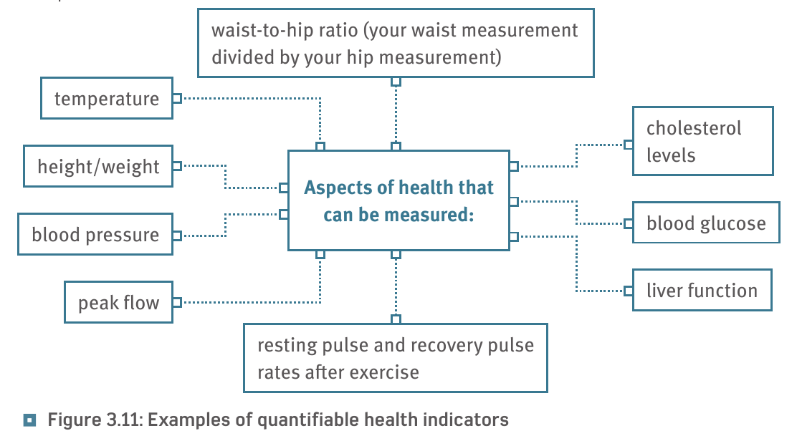
Health indicators…

Slide 3
Resting pulse rate and recovery after exercise…
This is a useful measure of health. The resting pulse rate is compared to the pulse rate after exercise.
The average resting rate is 40 - 60 beats per minute. the fitter you are the lower your resting pulse rate is. Babies and children have a faster rate.
The fitter you are the quicker the pulse rate takes to return to normal.
So you can measure how fit you are by measuring the pulse rate before exercise and seeing how many minutes it takes to return to normal.
The predicted pulse rate is 220 minus your age. A healthy pulse rate during or just after exercise is 60 to 80 % of this.
Here is an example for a 30year old.
Predicted pulse rate is 200 - 30 = 190
60% of 190 = 6o/100 x 190 = 114
80% of 190 = 80/100 x 190 = 152
Task:
Measure your pulse rate; you will be timed 60 seconds…

Slide 4
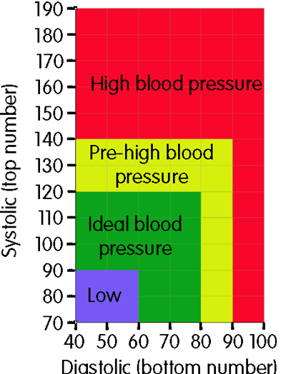
Blood pressure…
Blood pressure is recorded with 2 numbers:
The systolic pressure (higher number) is the force at which your heart pumps blood around your body.
The diastolic pressure (lower number) is the minimum pressure as the heart relaxes between beats.
Normal healthy blood pressure is between 90/60 mmHg and 120/80 mmHg.
Watch the video on how to read blood pressure…
https://youtu.be/3vulTEuIr-4

Slide 5
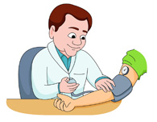
Blood pressure…
If you have blood pressure between 120/80 mmHg and 140/90 mmHg you are in danger of developing high blood pressure. This is also known as hypertension. This is a risk to health:
Heart disease, attacks and failure
Kidney disease
Strokes
Blindness
Vascular dementia

Slide 7
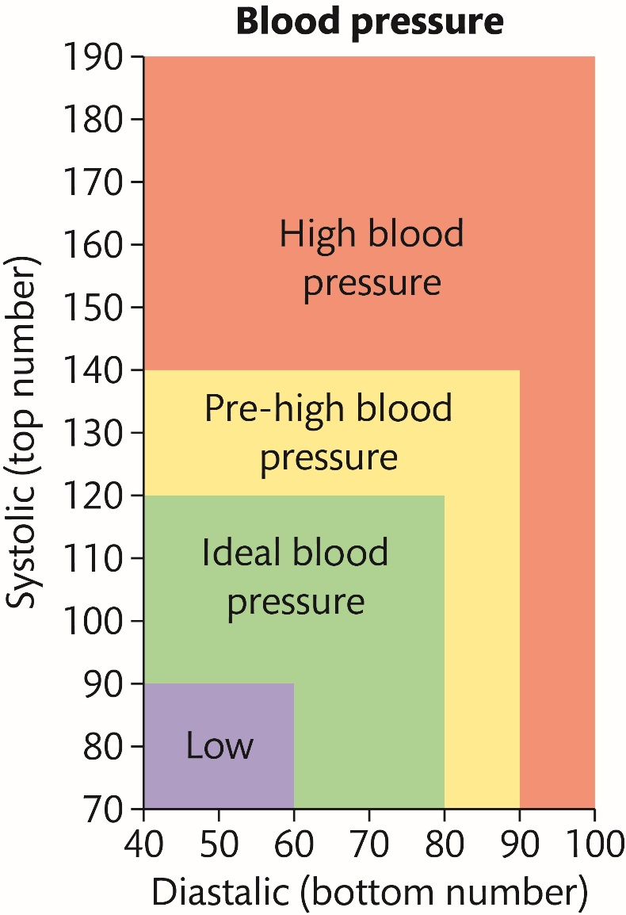
Blood pressure chart… task
Task:
Find the blood pressure readings for:
Billy has a blood pressure of 150/95
Baljit has a blood pressure of 190/97
Rebecca has a blood pressure of 110/70
Explain what the data suggests about:
The patients current physical health (3)
Their future physical health (3)
Notes:
Blood pressure is the pressure exerted by your blood against the walls of your arteries. It is measured in millimetres of mercury (mmHg) as two numbers shown one over the other.
The top number is your systolic pressure – the maximum pressure in the arteries as the heart pumps blood out around the body.
The bottom number is your diastolic pressure – the minimum pressure as the heart relaxes between beats.
Blood pressure is a health indicator. A blood pressure chart allows us to ascertain what someone’s blood pressure tells us about their health and wellbeing.
Normal healthy blood pressure is between 90/60 mmHg and 120/80 mmHg.
Ask students to look at this blood pressure chart to ascertain what it tells them about Billy’s reading of 150/95. (Billy has high blood pressure.)

Slide 8
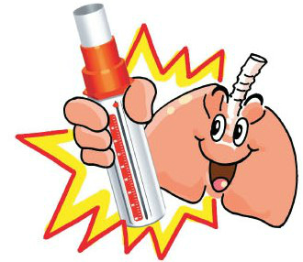
Peak Flow…
What is peak flow?
Peak flow is a simple measurement of how quickly you can blow air out of your lungs. It's often used to help diagnose and monitor asthma.
https://youtu.be/f1CBr0sSzv4

Slide 9
Peak flow…
https://youtu.be/wS8WxA_6vJA
The most common reason for measuring the peak flow is asthma and to check that it is not getting any worse.
It can also be used to diagnose and monitor
Bronchitis (a chest infection)
Emphysema (damage to the lungs causing breathlessness)
Cystic fibrosis (a genetic disorder that can affect the lungs)
Lung cancer

Slide 10
Peak flow chart
https://youtu.be/wS8WxA_6vJA
Task:
Find the peak flow reading for:
Billy is 45 years old.
He has a peak flow of 600 litres per minute.
He is 160 cm tall.
Explain what the data suggests about:
The patients current physical health (2)
Their future physical health (2)
This is what the peak flow should be!
Notes:
Peak flow is a measure of the maximum rate (or expiratory rate) in litres per minute (l/min) at which air is expelled from the lungs when you breathe out as hard as possible. Your peak flow reading shows if your airways are narrowed. It is measured using a handheld device called a peak flow meter.
Normal measurements of peak flow differ according to gender, age and height.
Peak flow is a health indicator. It can tell us how healthy our lungs are.
Ask students to study this chart and answer the question about Billy. (Billy has the expected peak flow for his height and age, so this suggests his lungs are healthy.)

Slide 11
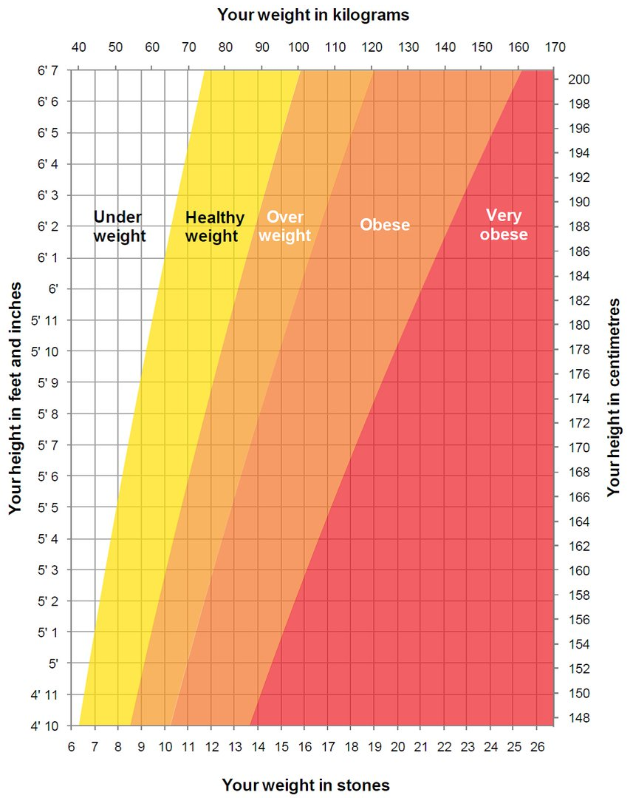
Body Mass Index (bmi)…
What is BMI?
BMI, or body mass index, is one way of measuring whether you’re a healthy weight for your height.
How to work out your BMI…
BMI = Weight
Height × Height
Example…
Billy weighs 55 kg and is 1.6 m tall.
55 divided by 1.6 x 1.6 = 21.5

Slide 12
The bmi chart…
BMI | Meaning
Less than 18.5 | Underweight
Between 18.5 and 24.9 | Healthy weight
Between 25 and 29.9 | Overweight
Between 30 and 34.9 | Obese
Between 35 and 39.9 | Severely obese
40 or above | Morbidly obese
Example…
Billy weighs 55 kg and is 1.6 m tall.
55 divided by 1.6 x 1.6 = 21.5
What is Billy’s BMI reading telling you?
Notes:
The BMI chart also shows that Billy is a healthy weight.

Slide 13
Why measure body fat (bmi)?
If someone has too much body fat they are at risk of:
cardiovascular disease
high blood pressure
diabetes
arthritis
stroke
If someone has a low amount of body fat they are at risk of:
an undiagnosed illness
an eating disorder such as anorexia nervosa or bulimia nervosa
Billy’s readings…

Slide 14
Pick a card…

