Slide 1
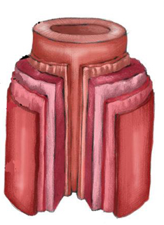
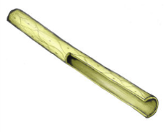
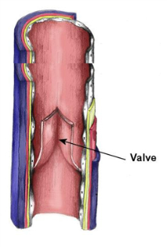
Research task:
Start:
Previous learning (last term):
Good = I have state the correct answers
Outstanding = I have explained the correct answers
Challenge = how does it effect SPORTING performance
Biceps job =
Quadriceps job =
Deltoids job =
Gastronomes job =
Independent work!
Plasma
Blood (vascular) Shunting:
What is this????
Previous learning (last week):
Function of the cardiovascular system
1
2
3
White blood cells
What are immediate effects of exercise on Circulatory System?
New learning :
Blood Pressure:
What is Blood Pressure?
What causes high blood pressure?
How can we reduce high blood pressure?
What is the danger of high blood pressure?
Red blood cells
Blood vessels: Arteries, Veins and Capillaries
What are long term effects of exercise on Circulatory System?
FIND OUT EACH JOB and STRUCTURE
Platelets
CARDIAC OUTPUT =
The formula to work our Cardiac Output is:
Find the structure and function of each
Stroke Volume =
Components of
Heart Rate =
Blood:

Slide 2
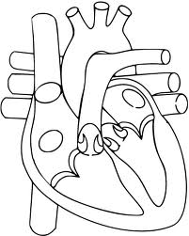
Extension:
3. Find information on the double circulation
Label the heart
Draw the direction of blood flow
4. CREATE A QUIZ, WITH ANSWERS ON WHAT YOU HAVE RESEARCHED

