Slide 1
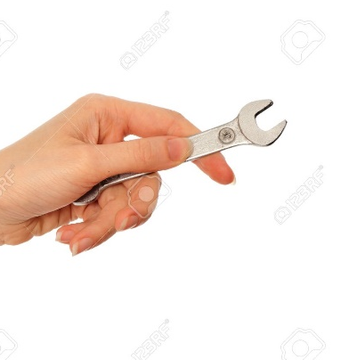
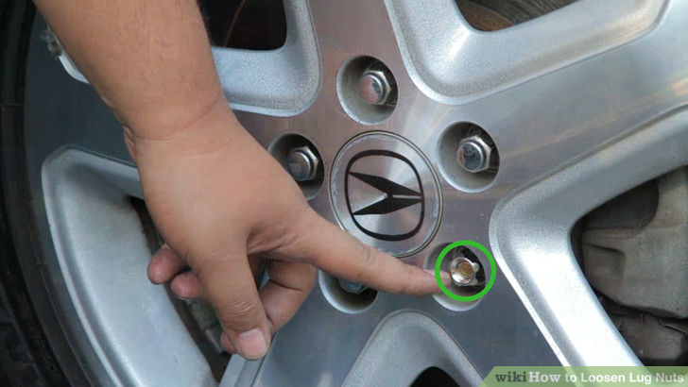
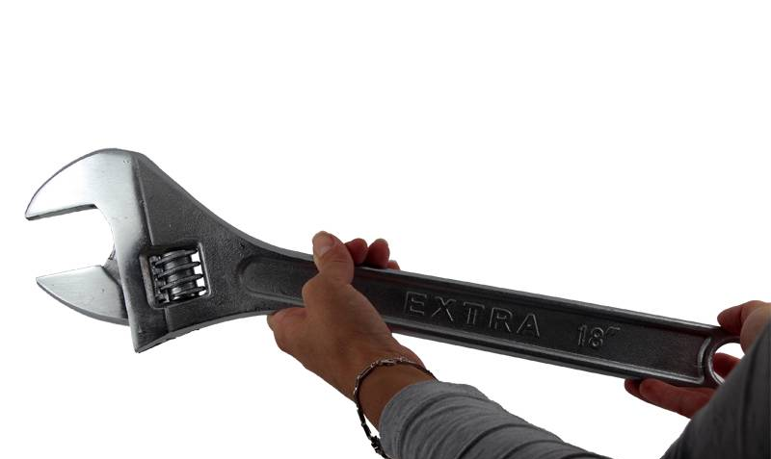
CwK
Wednesday, 01 July 2020
Moments
Do Now Activity
Which spanner would make it easier to take a nut off a wheel and why?

Slide 2
Self Assess
The longer the distance the greater the moment
The less force you need to exert
Easier to turn the long spanner compared to the short one

Slide 3
Progress Indicators
Good Progress
Recall the equation to calculate moments
Perform calculations, including rearrangement of the moment equation
Outstanding Progress
Apply the principle of moments to determine if an object is in equilibrium.

Slide 4
Word Consciousness
Moment-turning force

Slide 5
Moments are measured in Newton centimetres
(N cm) or newton metres (N m).
The moment of a force can be increased by
Increasing the size of the force
Increasing the distance

Slide 6
Equation
Moment, M= Force, F x perpendicular distance from the line of action of the force to the pivot, d
M=Fxd
M= Nm
F= N
d= m

Slide 7
Example
A force of 50N is exerted on a claw hammer of length 0.3m, calculate the moment of the force.
M= 50 x 0.3
M= 15Nm

Slide 8
Calculate clockwise and anticlockwise moment

Slide 9
When an object is balanced the
anticlockwise moment = the clockwise moment
In the example
The anticlockwise moment= 300 x 2= 600N
The clockwise moment= 400 x 1.5=600N
The clockwise and anticlockwise moments are the same so the see-saw is balanced or in equilibrium

Slide 10
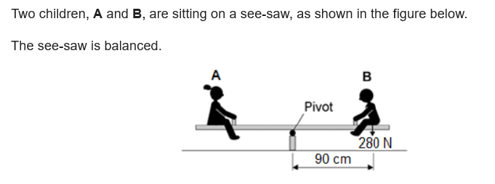
Calculate the moment of child B
Use the idea of moments to explain what happens when child B moves closer to the pivot.

Slide 11
Answer
moment = 280 × 0.9
moment = 252
the clockwise moment (of child B) decreases
making it is less than the anticlockwise moment (of child A)
so child A moves downwards or so child B moves upwards

Slide 12
Plenary

