Slide 1
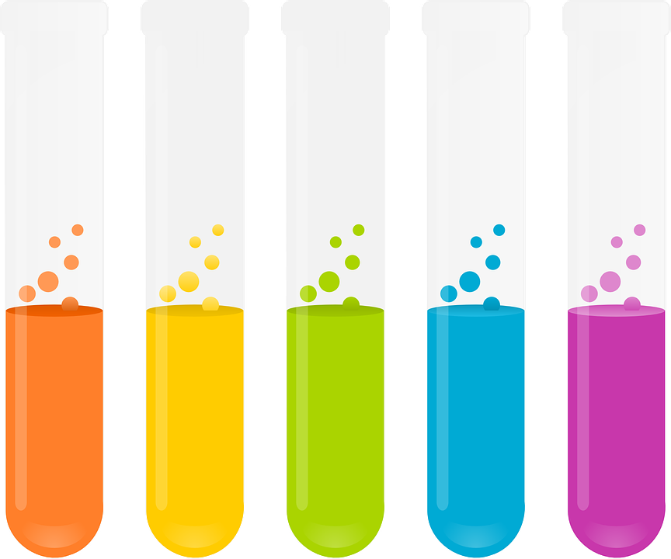
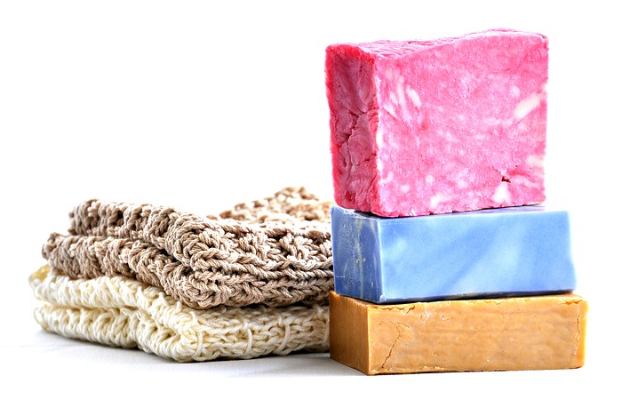
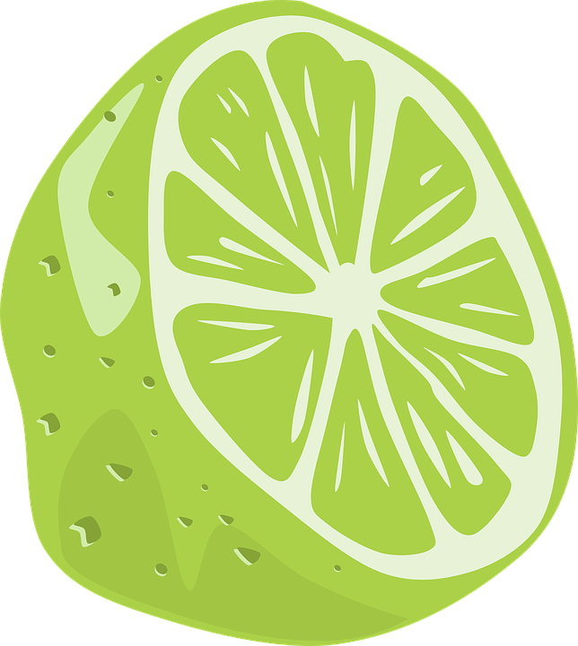
Indicators & pH
Do now activity: Describe some differences between acids and alkalis, give examples where you can.
Notes:
The author of this website quoted above. [CC BY-SA 4.0 (https://creativecommons.org/licenses/by-sa/4.0)]

Slide 2
Progress indicators
GOOD PROGRESS:
Recall some examples of indicators
Use the pH scale to measure acidity and alkalinity
OUTSTANDING PROGRESS:
Describe how indicators categorise solutions as acidic, alkaline or neutral.

Slide 3
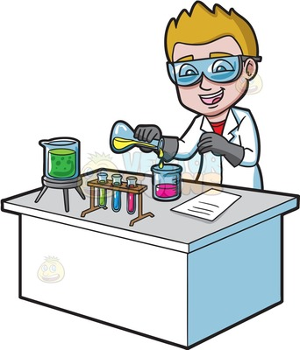
A student has two beakers. One contains an acid and the other contains an alkaline solution. How can he find out which is which?
I think we should taste the chemical to see what it tastes like. If it is an acid then it will taste sour, if it is an alkali it will taste soapy!
I think we should use another chemical that indicates whether it is an acid or an alkali. I don’t want to put an unknown chemical in my mouth!
Joel
Who do you agree with? Explain your answer!
Shayla

Slide 4
Task: Watch the video & fill in the blanks in the table:
Liquid | Blue litmus paper | Red litmus paper
Acid
Alkali
Liquid | Blue litmus paper | Red litmus paper
Acid | RED | BLUE
Alkali | BLUE | RED
Extra Challenge: What is the disadvantage of using red & blue litmus papers as indicators?
Notes:
Skip parts of the video about ions

Slide 5
The pH scale
Strength, acid, alkali, acid, scale, strong, purple
Task: Copy and complete the sentences:
Litmus paper tells us whether something is an _______ or an alkali.
But it does not tell us the ________ of the acid or alkali.
A universal indicator can tell us whether we have strong _____ or a strong ______ by producing a pH ________.
Red means a _________ acid, ______ means a strong alkali. Green means a neutral solution.

Slide 6
Self-assessment:
Litmus paper tells us whether something is an acid or an alkali.
But it does not tell us the strength of the acid or alkali.
A universal indicator can tell us whether we have strong acid or a strong alkali by producing a pH scale.
Red means a strong acid, blue means a strong alkali. Green means a neutral solution.

Slide 7
How acidic? How alkaline?
Task: Read the information on the next slide and complete these questions in your book:
What is universal indicator?
What does the pH scale show us?
If a pH is less than 7 what does that tell us about a solution?
If a pH is more than 7 what does that tell us about a solution?
What is a neutral solution?

Slide 8
How acidic? How alkaline?
We can’t use litmus paper to find out the strength of vinegar compared to stomach acid or lemon juice. As the paper would turn red, regardless of strength.
Instead, you need universal indicator. Universal indicator is a mixture of dyes, it changes colour to show how acidic or alkaline the solution is.
The pH scale is the measure of the strength of an acidic or alkaline solution.
An acid will always have a pH lower than 7, the closer to 1 the pH is the stronger the acid is.
An alkali has a pH of more than 7, the higher the pH the more alkaline the solution is.
Some solutions are neutral, this means neither acidic or alkane – this pH of a neutral solution is exactly 7

Slide 9
Self-assessment:
What is universal indicator?
Universal indicator is a mixture of dyes, it changes colour to show how acidic or alkaline a solution is.
2. What does the pH scale show us?
The pH scale is a measure of how acidic or alkaline a solution is.
3. If a pH is less than 7 what does that tell us about a solution?
It tells us that it is an acidic solution
4. If a pH is more than 7 what does that tell us about a solution?
It tells us that it is an alkaline solution
What is a neutral solution?
A neutral solution is one that is neither acidic or alkaline, it has a pH of 7.

Slide 10
Literacy Check – Linking words
Task: Link the following groups of words together into a sentence:
Acid, alkali, indicator
pH scale, indicator, neutral
Red, pH 1, hydrochloric acid

