Slide 1
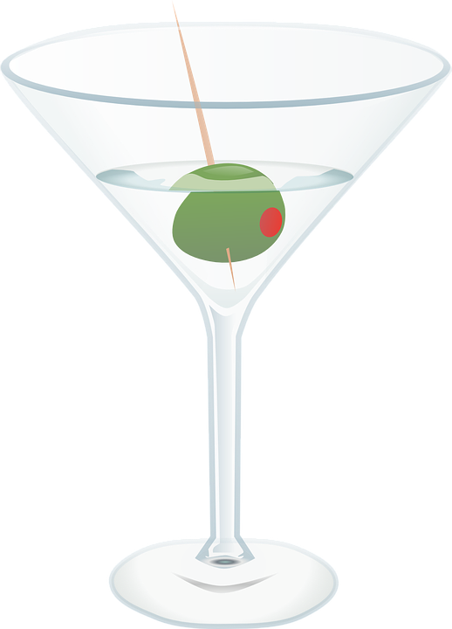
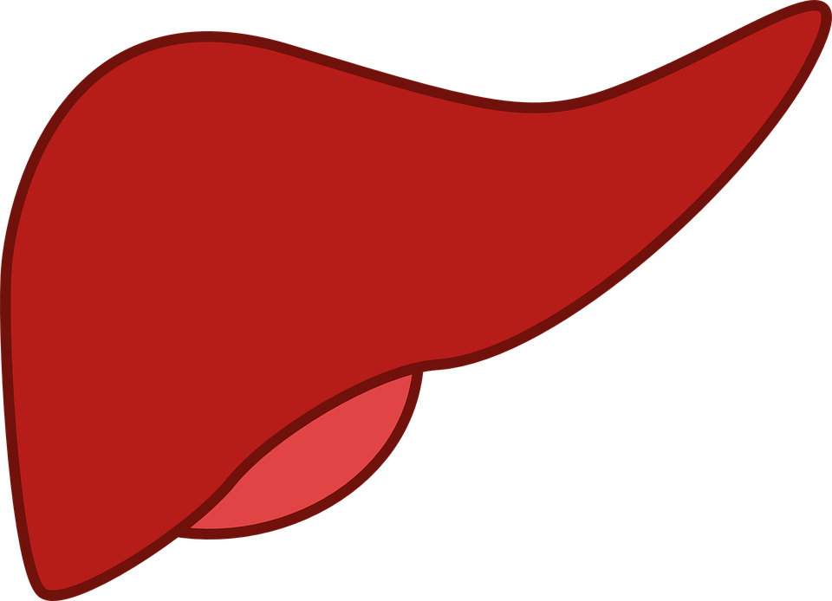
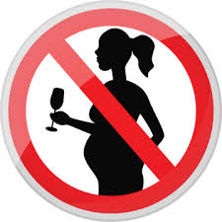
Alcohol
Do now activity: What is the difference between a medicinal drug and a recreational drug?

Slide 2
Progress indicators
GOOD PROGRESS:
Recall the dangers of drinking alcohol
OUTSTANDING PROGRESS: Describe the health effects of alcohol on different parts of the body

Slide 3
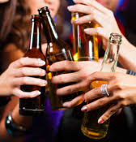
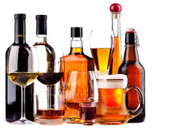
Alcohol and health
Alcohol is the most common used social drug in many parts of the world. It is very addictive and poisonous, although the liver can usually remove it before permanent damage or death results.
How does alcohol affect your body?
https://www.youtube.com/watch?v=V2Aj-iJ6p38

Slide 4
Self-assessment:
Neurotransmitters of the brain transmit information more slowly
Changes to the structure of the brain
Stroke
How does alcohol affect your body?
Fibrosis/Cirrhosis of the liver
Mood swings
Memory loss and lack of coordination
Cardiomyopathy/Arrythmias
Cancer
Alcohol can make you feel drowsy

Slide 5
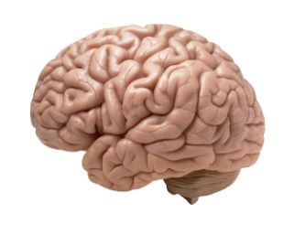
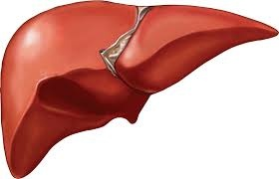
Brain & Liver Damage
People can easily become addicted to alcohol. Their liver and brain may suffer long-term damage and eventually the alcohol can kill them.
Cirrhosis of the liver – a disease which destroys healthy liver tissue.
Alcohol is a carcinogen – heavy drinkers are at risk of developing liver cancer.
Long-term heavy alcohol use can cause damage to the brain. Brain structures are eventually lost and no longer can function properly.

Slide 6
Task: Fill in the blanks:
People can easily become _______ to alcohol. Their _____ and _____ may suffer long-term _______ and eventually the ______ can kill them.
Cirrhosis of the liver – a disease which destroys healthy _____ ______.
Alcohol is a _______ – heavy drinkers are at risk of developing liver cancer
Long-term heavy alcohol use can cause damage to the ______. Brain structures are eventually lost and no longer can function properly.
Addicted, brain, liver, brain, carcinogen, damage, liver cells, alcohol

Slide 7
Self-assessment:
People can easily become addicted to alcohol. Their liver and brain may suffer long-term damage and eventually the alcohol can kill them.
Cirrhosis of the liver – a disease which destroys healthy liver cells.
Alcohol is a carcinogen – heavy drinkers are at risk of developing liver cancer
Long-term heavy alcohol use can cause damage to the brain. Brain structures are eventually lost and no longer can function properly.

Slide 8
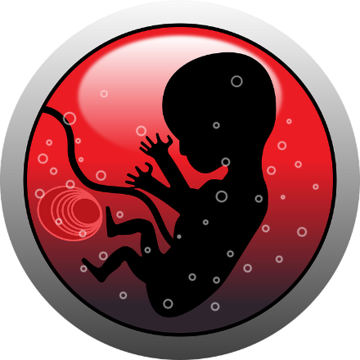
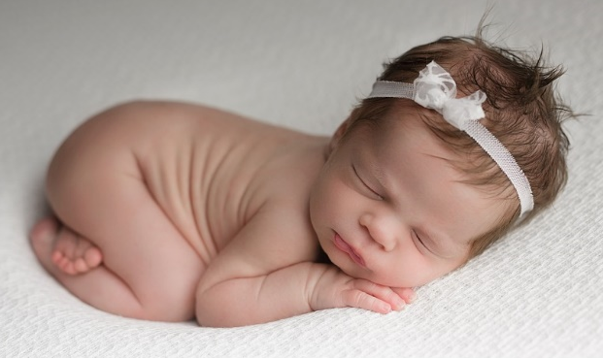
Alcohol and pregnancy
Task: Watch the video and answer the following questions:
How does alcohol reach a growing baby?
What are some of the alcohol-related problems linked to drinking during pregnancy?
What is the most severe disorder that occurs if women drink during pregnancy? Describe some of the symptoms of this condition.
https://www.youtube.com/watch?v=od13ZcQizWQ

Slide 9
Self-assessment:
Alcohol enters the bloodstream of the mother, moves through the placenta and into the baby’s bloodstream.
High levels of alcohol are toxic and can cause damage to the brain and other organs, prolonged exposed to alcohol in utero can lead to miscarriages and still birth plus a condition called fetal alcohol syndrome.
Fetal alcohol syndrome is a serious condition which can lead to facial and heart abnormalities, mental retardation and behavioural problems.

Slide 10
Dangers of alcohol
20 -
18 -
16 -
14 -
12 -
10 -
8 -
6 -
4 -
2 -
0 -
Deaths per 100,000 population
1992 1994 1996 1998 2000 2002 2004 2006
year
How many men and women died of alcohol-related diseases per 100,000 of the population in 1992? (2 marks)
Describe how the death rate for men and women changed from 1992 to 2008? (3 marks)
c) Suggest reasons for the increase in alcohol-related deaths (3 marks)

Slide 11
Self-assessment:
a) How many men and women died of alcohol-related diseases
per 100,000 of the population in 1992? (2 marks)
In 1992, 5 women and 9 men per 100,000 died due to alcohol.
b) Describe how the death rate for men and women changed from 1992 to 2008? (3 marks)
From 1992 both the number of men and women dying from alcohol increased.
In men this number increased more dramatically, doubling
in numbers from 9 to 18 deaths per 100,000.
In women the numbers increased more gradually, from 5 to 9
deaths per 100,000.

Slide 12
c) Suggest reasons for the increase in alcohol-related deaths
(3 marks)
Alcohol became cheaper to purchase in shops and some bars
There are more advertisements on TV and in supermarkets for alcoholic brands
It became easier for younger people to access alcohol
People experiencing high amounts of stress due to jobs/lifestyle may increase amount they drink alcohol.

