Slide 1
Revenue
Notes:
Please note that the symbols and buttons behave as follows:
HYPERLINKS – where there is a hyperlink this symbol will be shown in the margin. More information about the hyperlink is given in the notes for each slide
BACK BUTTON – used where hyperlinks have been used to move to a given slide. This button will take you back to the slide the link was from
FORWARD BUTTON – this allows you to move forward to the next section (if there is one) of the presentation. This may skip a number of slides that are linked to from the slide the button appears on.

Slide 2
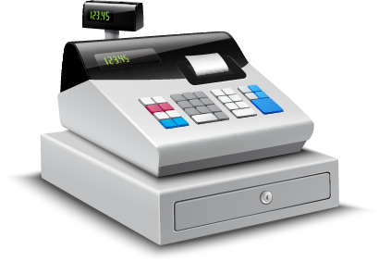
Progress Indicators
Outstanding – I can calculate total revenue

Slide 3
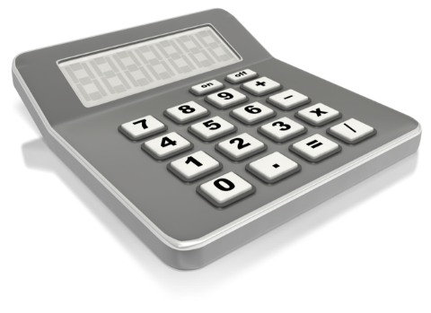
Revenue
Revenue refers to the money that
a business receives
Most of this will come from selling
goods and services
  This is often referred to as
  “Sales Revenue”
Sales Revenue can be calculated as:
SALES REVENUE
=
SELLING PRICE PER UNIT
x
QUANTITY OF UNITS SOLD

Slide 4

Sir Ramics: An Example of Revenue
Sir Ramics is a small pottery business that produces coffee mugs
Last month it made 30,000 mugs and
sold them all at a price of 50p each:
The owner, Ken Coe, would
like to know what his revenue
was last month:
Revenue
Revenue = Selling Price x Quantity of units sold
Revenue = £0.50 x 30,000
Revenue = £15,000
This is the sales revenue that Sir Ramics received last month.
Since no other revenue was received then Sir Ramics total revenue last month was £15,000
Notes:
Click to reveal each stage of the calculation

Slide 5

Calculating Revenue
Amount Sold: 22,525
Price: £0.50
Selling Price: £40
Quantity Sold: 1,000
Selling Price: £9.99
Quantity Sold: 2,555
22,525 x 0.50
£40 x 1,000
= £11,262.50
= £40,000
£9.99 x 2,555
= £25,524.45

