Slide 1
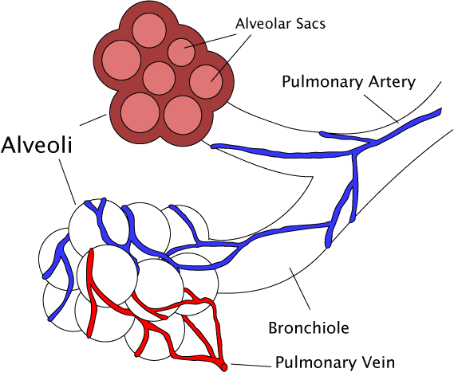
Breathing & Gas Exchange
Do Now activity:
Identify some of the organs involved in the gas exchange system in the human body.
Discuss with your partner what function of some of these organs might be within this system
Explain why organisms need an efficient gas-exchange system
Notes:
By The original uploader was Pdefer at English Wikipedia [GFDL (http://www.gnu.org/copyleft/fdl.html) or CC-BY-SA-3.0 (http://creativecommons.org/licenses/by-sa/3.0/)], via Wikimedia Commons

Slide 2
Progress indicators
GOOD PROGRESS:
- To label the main organs in the gas exchange system
- To describe the events that take place during inhalation and exhalation
OUTSTANDING PROGRESS:
- To explain the major adaptations of an efficient gas exchange system

Slide 3
https://www.youtube.com/watch?v=8NUxvJS-_0k
Task: Answer the following questions:
When your breathe in, where does oxygen eventually get transported to?
When you breathe in air, what happens to the:
diaphragm:
Intercostal muscles:
What structure is held at the end of the bronchioles?
What is wrapped around the alveolus?
What gas passes out of the blood and into the alveolus for us to breathe out?

Slide 4
Self-assessment:
The oxygen firstly gets transported to your heart and then it is delivered to respiring cells in the rest of your body.
a) The diaphragm contracts, lying flat
b) The intercostal muscles contract, this pulls the rib cage up and out. (Both of these actions increase the volume of the thorax which lowers the thoracic pressure, meaning air rushes in from outside, down a pressure gradient).
Alveoli are found at the end of bronchioles.
Around the alveolus are capillaries, carrying deoxygenated blood to the lungs and oxygenated blood away from the lungs.
Carbon dioxide gas is brought back to the lungs by the blood, away from respiring body tissues. This waste gas diffuses into the alveoli and we breathe it out into the environment.

Slide 5
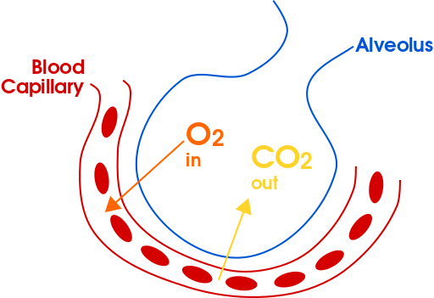
Task: You will be given some information on the respiratory system and gas exchange. You will need to use this information to complete the answers on sheet
Notes:
Image: By domdomegg - Own work, CC BY 4.0, https://commons.wikimedia.org/w/index.php?curid=46639201

Slide 6
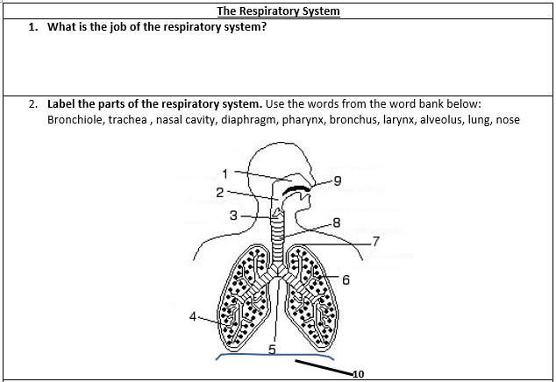
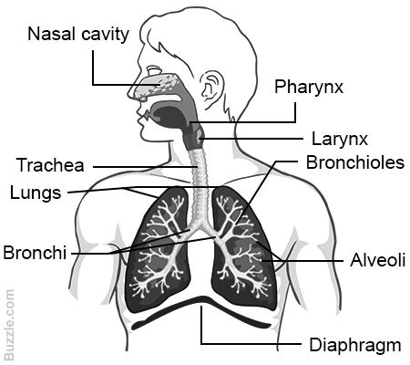
Self-assessment:
The lungs are part of the respiratory system which is adapted for two functions:
ventilation – the movement of air into and out of the lungs
gas exchange – the 'swapping’ of gases between the alveolar air and the blood

Slide 7
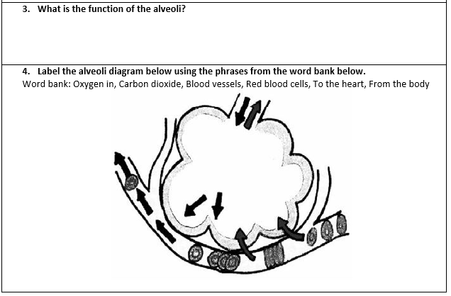
Tiny air sacs with a high surface area which have thin wall and a specialised surface for gas exchange.
From the body
To the heart
Red blood cells
Notes:
Image: By domdomegg - Own work, CC BY 4.0, https://commons.wikimedia.org/w/index.php?curid=46639201

Slide 8
Task: Copy and complete the following sentences:
There are three main gases that are taken in and removed from the body, these are _______, _______ and _______ ________.
During inhalation (breathing in) our body takes in _______, which is absorbed into our blood stream. This process occurs in the _______.
During exhalation (breathing out) our body removes ______ _______ from the ______.
Word Bank: You can use these more than once:
Oxygen, blood, alveoli, carbon dioxide, nitrogen
oxygen
nitrogen
carbon
dioxide
oxygen
alveoli
carbon
dioxide
blood
Extra challenge: Explain what is meant by the term ‘gaseous exchange’

Slide 9
Adaptations of the alveoli
Task: We are going to watch a quick animation of gas exchange occurring in the alveoli, think about the alveolar adaptations which make this an efficient gas exchange surface
From the body
To the heart
Red blood cells
http://www.bbc.co.uk/schools/gcsebitesize/science/triple_aqa/movement_of_molecules/gaseous_exchange_lungs/revision/3/
Notes:
Image: By domdomegg - Own work, CC BY 4.0, https://commons.wikimedia.org/w/index.php?curid=46639201

Slide 10
Task: You will need to draw this table below and fill it in using the information cards I will distribute around the room:
Feature of the alveoli | How does this feature help the alveoli to carry our gas exchange more efficiently?
Large surface area
Surrounded by capillaries (blood vessels)
Thin wall
Well ventilated

Slide 11
1. Copy this table into your books to show the percentage of air we breathe in and breathe out
Gas | % of air breathed in | % of air breathed out
Nitrogen | ~80 | ~80
Oxygen | ~20 | ~16
Carbon dioxide | ~0.04 | ~4
2. Draw a bar chart of the data above to compare the percentage of different gases found in breathed in vs. breathed out air

Slide 12
Task: Exam-style question:
Oxygen is absorbed into the blood through specialised structures called alveoli.
a) What is the name of the gas that moves from the blood back out into the alveoli, in order to be breathed out? (1 mark)
b) What is the name of the process by which oxygen moves into the alveoli?
(1 mark)
b) Give two adaptations of the alveoli that helps the rapid absorption of oxygen into the blood (2 marks)
4 marks = 4 minutes
Challenge yourself by closing your book and completing it from memory!

Slide 13
Self-assessment:
Carbon dioxide
Diffusion
Any two from:
Alveoli have a very good blood supply, this maintains a concentration gradient between the alveoli and the capillaries so that diffusion of oxygen occurs quickly
Alveoli have very thin walls so the diffusion pathway is very short, this means oxygen can diffuse through the wall quickly and easily
Alveoli have a very high surface area meaning there is more space for oxygen to move across from the alveoli to the blood.

Slide 14
Plenary: Write a tweet about what we have learnt today!
Remember: No more than 140 characters ☺
#keywords

Slide 15
When your breathe in, where does oxygen eventually get transported to?
When you breathe in air, what happens to the:
diaphragm:
Intercostal muscles:
What structure is held at the end of the bronchioles?
What is wrapped around the alveolus?
What gas passes out of the blood and into the alveolus for us to breathe out?
When your breathe in, where does oxygen eventually get transported to?
When you breathe in air, what happens to the:
diaphragm:
Intercostal muscles:
What structure is held at the end of the bronchioles?
What is wrapped around the alveolus?
What gas passes out of the blood and into the alveolus for us to breathe out?

Slide 16
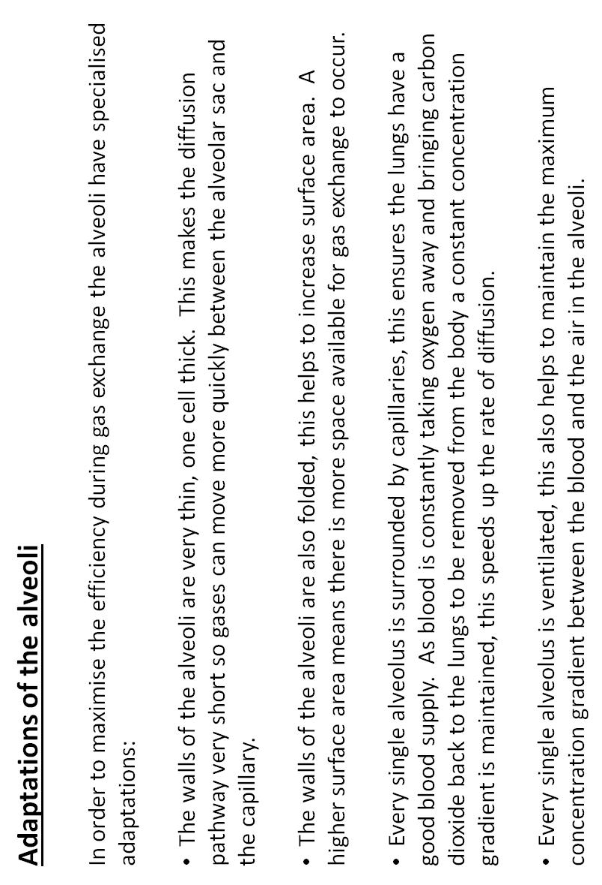
Notes:
Cut these bullet points of information into cards/strips, give each student a piece of information. They will need to share information to complete their table.

Slide 17
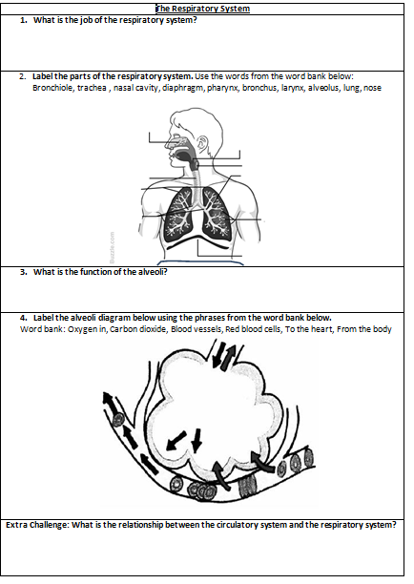

Slide 18
