Slide 1
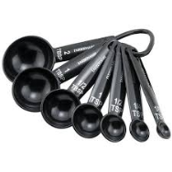
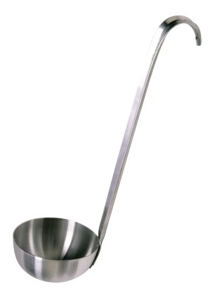
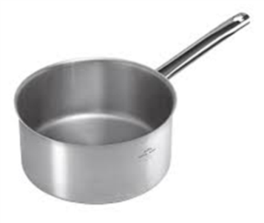
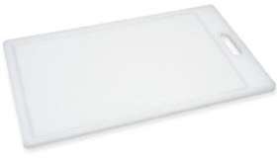
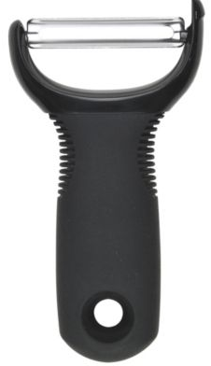
Step by step Tomato Soup
INGREDIENTS
1 onion
1 carrot
1 potato
1 x 400g Passata/chopped tomatoes
500ml water
1 stock cube
1/2 x 5ml spoon dried chilli flakes( spicy)
1 x 15ml spoon tomato puree
Basil
A container to take your soup home in
EQUIPMENT
Chopping board
Vegetable peeler
Sharp Knife
Saucepan
Measuring spoons
Wooden spoon
Blender
Ladle
METHOD
1. Prepare the vegetables:
peel and slice the onion;
top and tail, peel and slice the carrot;
peel and cut the potato into small dice.
2. Fry the onions, carrots and potato ,and garlic if used, in the oil for 3-4 minutes until soft.
3. Add the tomatoes
4. Simmer gently for about 10 minutes, covered, stirring occasionally.
5. Add tomato puree, water and stock cube.
6. Cook for 20 minutes.
7. Sprinkle with torn basil leaves or Chilli flakes, stir thoroughly.
8. Whilst your soup is cooking, wash up your equipment and clean your work areas.
9. Carefully transfer to the blender if a smooth texture is required.

Slide 2
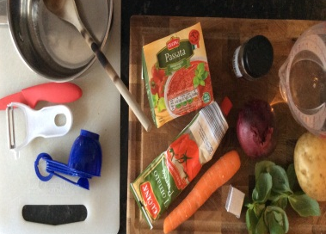
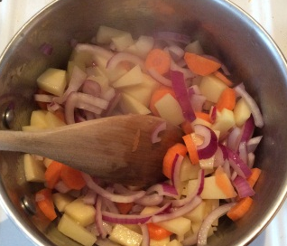
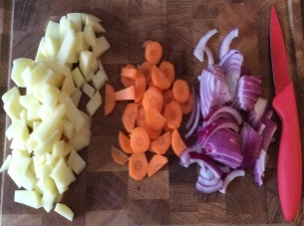
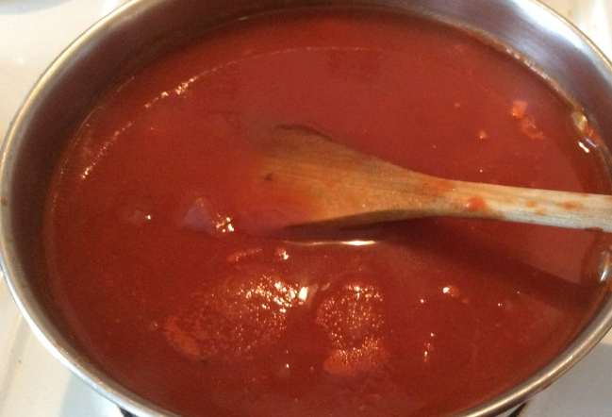
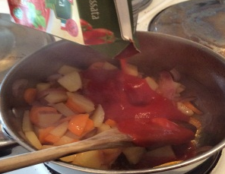
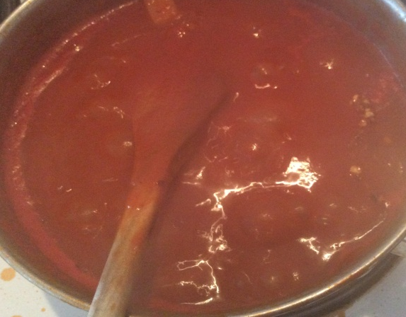
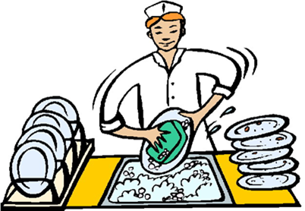
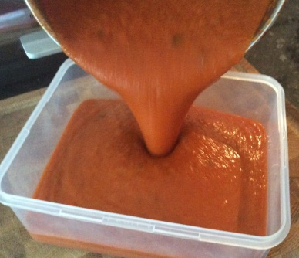
Step by Step Tomato Soup
1. Prepare yourself and your equipment.
Prepare the vegetables: peel and slice the onion; top and tail, peel and slice the carrot; peel and cut the potato into small dice.
2. Fry the onions, carrots and potato ,and garlic if used, in the oil for 3-4 minutes until soft.
3. Add the tomatoes (Passata or canned)
4. Simmer gently for about 10 minutes, covered, stirring occasionally.
5. Add tomato puree, water and stock cube.
6. simmer for 20 minutes.
7. Sprinkle with torn basil leaves or Chilli flakes, stir thoroughly.
8. Whilst your soup is cooking, wash up your equipment and clean your work areas.
9. Carefully blender if a smooth texture is required.

